Slide 1


The Risky Business of Safe Investing Optimizing Conservative Portfolios
FA24-AAI-500 FINAL PROJECT
PRESENTED BY CARRIE LITTLE AND IAN LUCAS
https://github.com/littlecl42/AAA500_FinalProject_CL_IL
Notes:
Good morning and thank you for joining us today.
I’m Carrie Little. My partner, Ian Lucas and I will walk you through our financial portfolio proposal titled
The Risky Business of Safe Investing: Optimizing Conservative Portfolios
Today, we will examine how we’ve designed this portfolio to balance risk, maximize returns, and align with the customer’s financial goals.

Slide 2

Agenda
Introduction
Data Overview
Data Analysis
Portfolio Strategies
Key Findings
Recommendations
Conclusion
Next Steps
https://github.com/littlecl42/AAA500_FinalProject_CL_IL
Notes:
Here’s a quick overview of our agenda for this presentation.
We will begin with an Introduction where I'll provide some background on our approach and key objectives.
Next, we'll look at a Data Overview, focusing on the sources and types of data we’ve used.
Following that, we’ll dive into Data Analysis, covering insights such as correlations, risk characteristics, and volatility metrics of different assets.
We’ll then explore the Portfolio Strategies that include different approaches, such as Risk Parity, Minimum Variance, and Maximum Diversification, and how these strategies align with the customer’s financial goals.
Afterwards, we'll discuss the Key Findings from our analysis, including return distributions, risk profiles, and the benefits of diversification.
Based on these findings, we’ll present our Recommendations for optimizing the customer’s portfolio structure.
We'll then conclude with a Conclusion summarizing the key points and a Next Steps section to outline how we can move forward.
This agenda will ensure everyone gets a complete picture of our portfolio design and why it’s suited to meet our customer’s financial goals.

Slide 3

Introduction
Background
Significant client losses in 2022 prompted a shift to safer Treasury Bills. With rate cuts now likely, clients are looking for alternative strategies that return over 4% with reduced risk.
Goal
Explore new investment strategies using liquid funds, comparing Risk Parity, Minimum Variance, and Maximum Diversification approaches to provide enhanced returns while managing risks.
https://github.com/littlecl42/AAA500_FinalProject_CL_IL
Notes:
First, let’s talk about the Background.
In 2022, we experienced significant client losses due to market volatility, which led many investors to shift their focus towards safer options like Treasury Bills.
With potential rate cuts on the horizon, clients are now seeking alternative investment strategies that can deliver returns above 4% while minimizing risk.
This brings us to our Goal. Today, we’ll explore innovative investment strategies that utilize liquid funds.
Specifically, we’ll compare three approaches: Risk Parity, Minimum Variance, and Maximum Diversification.
The aim is to find ways to enhance returns while keeping risk levels manageable.
Each strategy has unique strengths, and our objective is to determine which best meets the client’s financial needs in this evolving environment.
With that in mind, let’s move on to the details.

Slide 4

Data Overview
Dataset
Monthly returns from 15 ETFs and mutual funds from November 2014 to August 2024.
Assets - Vanguard LifeStrategy (benchmark), Bitcoin, Treasury ETFs, Gold, VIX, commodities, market neutral, long-short equity, etc.
Sources
From Portfolio Visualizer; standardized with no missing values.
https://www.portfoliovisualizer.com/backtest-portfolio?s=y&sl=5M8RhWX2CyedGtfIDJRlyP
https://github.com/littlecl42/AAA500_FinalProject_CL_IL
Notes:
I’d like to provide an overview of the data that forms the foundation of our analysis.
Let’s start with the Dataset. We used monthly returns data from 15 different ETFs and mutual funds, spanning from November 2014 to August 2024.
This dataset includes a diverse range of assets, such as Vanguard LifeStrategy, which serves as our benchmark, along with Bitcoin, Treasury ETFs, Gold, VIX, commodities, market-neutral funds, and long-short equity strategies.
This variety allows us to analyze both traditional and alternative investments, providing a comprehensive perspective on portfolio performance.
The Sources of our data are from Portfolio Visualizer, a robust platform for financial analysis.
We ensured that the data was standardized, with no missing values, so that our analysis is both reliable and accurate.
If you would like more detailed information, you can find the full dataset at the link provided at the bottom of this slide.

Slide 5
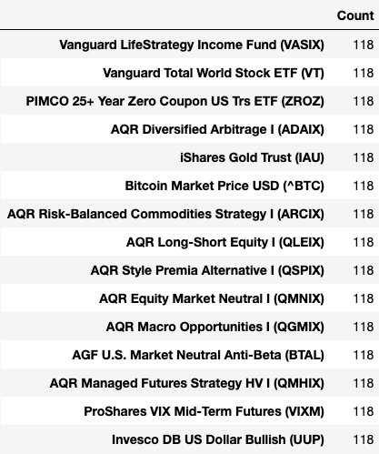
Individual Assets
https://github.com/littlecl42/AAA500_FinalProject_CL_IL
Notes:
Let’s take a closer look at the individual assets included in our dataset.
The table on this slide shows the list of assets we analyzed, along with the count of monthly data points available for each one.
As you can see, we have 118 months of data for each asset, spanning from November 2014 to August 2024, providing us with a comprehensive time frame for analysis.
The assets include a diverse mix of investment options:
Vanguard LifeStrategy Income Fund (VASIX) serves as our benchmark, offering a low-risk, conservative approach.
Vanguard Total World Stock ETF (VT) provides global equity exposure.
PIMCO 25+ Year Zero Coupon US Treasury ETF (ZROZ) and iShares Gold Trust (IAU) add an element of fixed income and precious metals, respectively, providing stability and hedging benefits.
Bitcoin (BTC) adds a layer of higher-risk, high-reward potential, which helps balance other more conservative elements of the portfolio.
We also included several AQR funds, such as AQR Diversified Arbitrage (ADAIX), AQR Risk-Balanced Commodities Strategy (ARCIX), and AQR Managed Futures Strategy HV I (QMHIX), each adding unique dimensions of strategy-based investing.
The AGF U.S. Market Neutral Anti-Beta (BTAL) and Invesco DB US Dollar Bullish (UUP) provide defensive characteristics and a hedge against market downturns.
The wide variety of assets—including equities, fixed income, commodities, currencies, and alternative strategies—ensures we have a well-rounded dataset that captures a broad spectrum of market conditions.
This diversity helps us understand the behavior of different asset classes and their contributions to a balanced portfolio.
This detailed data enables us to evaluate risk, return, and correlation metrics effectively, giving us deeper insights into how these assets perform both individually and as part of a cohesive strategy.

Slide 6
Data Analysis
Risk and Return Characteristics
Benchmark: Growth Rate 3.4%; Volatility 5.6%; Max Drawdown 16.7%
Growth Rates: 8 Assets > 5%; 4 Assets 0-5%; 2 Assets < 0%
Volatility: 4 Assets < 10%; 8 Assets 10-20%; 3 Assets > 20%
Max Drawdown: 3 > -15%; 3 Assets -15 to -30%; 8 Assets
https://github.com/littlecl42/AAA500_FinalProject_CL_IL
Notes:
Next, let’s dive into the Risk and Return Characteristics of the individual assets in our portfolio.
To start, Bitcoin stands out as the asset with the highest risk, which is characterized by significant volatility.
While it has demonstrated substantial return potential, it also comes with considerable downside risk, making it suitable for investors willing to tolerate this level of uncertainty for the chance of outsized returns.
On the other end of the spectrum, we have market-neutral assets such as AQR Diversified Arbitrage (ADAIX) and AQR Equity Market Neutral (QMNIX).
These assets are designed to minimize market exposure, which helps in providing more stable returns.
They play a critical role in mitigating overall portfolio risk, particularly during volatile market periods.
Gold and other commodities provide moderate volatility, which means they offer a middle ground—less risky compared to Bitcoin but still with the ability to provide a hedge against inflation and market downturns.
These assets are valuable for maintaining balance within the portfolio.
Overall, this analysis helps us understand the role of each asset in achieving a diversified risk-return profile.
High-risk, high-reward assets like Bitcoin are balanced with more stable, market-neutral assets, while gold and commodities provide both moderate returns and risk reduction.
This balanced approach is key to managing both growth and risk for the portfolio.

Slide 7
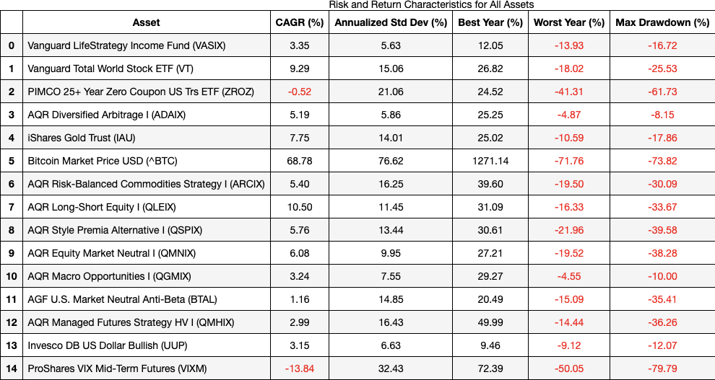
Asset Performance Summary
https://github.com/littlecl42/AAA500_FinalProject_CL_IL
Notes:
Correlation with VASIX
Vanguard Total World Stock ETF (VT) has the highest positive correlation with VASIX (0.80), indicating a similar return behavior.
PIMCO 25+ Year Zero Coupon US Trs ETF (ZROZ) also has a relatively strong correlation with VASIX (0.62).
AGF U.S. Market Neutral Anti-Beta (BTAL) and Invesco DB US Dollar Bullish (UUP) have negative correlations with VASIX, suggesting they could provide effective diversification.
Risk Characteristics (Std Dev)
Bitcoin (^BTC) has the highest standard deviation (22.12%), indicating the highest risk and volatility.
AGF U.S. Market Neutral Anti-Beta (BTAL) and PIMCO 25+ Year Zero Coupon US Trs ETF (ZROZ) have relatively low standard deviations (4.29% and 6.08%, respectively), suggesting they may be less volatile.
Vanguard LifeStrategy Income Fund (VASIX) itself has a low standard deviation (1.63%), reflecting its conservative nature.
Skewness and Kurtosis
Bitcoin (^BTC) and ProShares VIX Mid-Term Futures (VIXM) have high positive skewness, implying occasional extreme positive returns.
AGF U.S. Market Neutral Anti-Beta (BTAL) and AQR Managed Futures Strategy HV I (QMHIX) exhibit negative skewness, suggesting a propensity for extreme negative returns.
PIMCO 25+ Year Zero Coupon US Trs ETF (ZROZ) shows notable positive kurtosis, indicating the presence of extreme return events or outliers.
Return Distribution
Vanguard LifeStrategy Income Fund (VASIX) has a mean monthly return of 0.29%, reflecting stable performance with moderate risk.
Bitcoin (^BTC) has the highest mean return (6.67%) but also the highest volatility, illustrating a risk-return trade-off.
AGF U.S. Market Neutral Anti-Beta (BTAL) has one of the lowest mean returns (0.29%) with moderate skewness and high kurtosis, showing its defensive characteristics.
Min and Max Returns
Bitcoin (^BTC) has the widest range of returns, with a minimum of -40.60% and a maximum of 72.00%, underscoring its high risk profile.
Vanguard LifeStrategy Income Fund (VASIX) and AGF U.S. Market Neutral Anti-Beta (BTAL) have narrow ranges, reflecting lower risk exposure and limited potential for extreme outcomes.

Slide 8
Data Analysis
Correlation Matrix Heatmap (Lower Triangle)
Visually represents how each asset in the portfolio correlates with the others
Helps identify opportunities for diversification
Optimize the asset mix to minimize risks
12 Month Rolling Cross Correlations
Fluctuations in correlation
Outlier Analysis
Correlation Summary Table
Compares VASIX and other assets
Summary of Average Positive And Negative Correlations
https://github.com/littlecl42/AAA500_FinalProject_CL_IL
Notes:
Next, we’ll be discussing some key Correlation Insights derived from our analysis.
First, the Correlation Matrix Heatmap, visually represents how each asset in the portfolio correlates with the others.
This heatmap helps us identify opportunities for diversification and optimize the asset mix to minimize risks while maintaining growth potential.
This matrix provides insight into visualizing a portfolio that balances risk and return by leveraging assets with low or negative correlations for increased diversification while considering similar assets for targeted exposure.
Rolling Correlations and Outlier Analysis.
The rolling correlation analysis and the correlation summary table help us understand how the relationships between assets change over time and which assets are most effective in reducing overall risk.
We can see fluctuations in correlation, which highlight the importance of maintaining a flexible investment strategy.

Slide 9
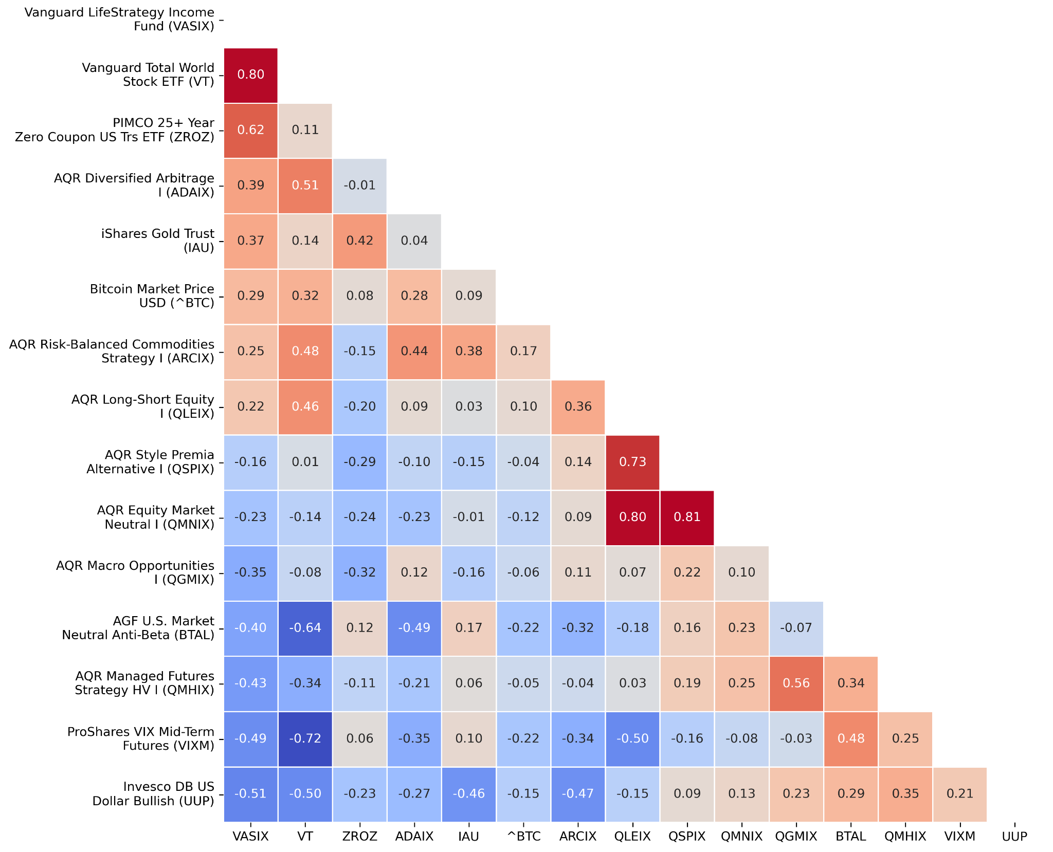
Correlation Matrix
Heatmap
(Lower Triangle)
Correlation Insights
Vanguard Total World Stock (VT) correlates highest with Vanguard LifeStrategy (VASIX) at 0.80
Correlation Insights
Numerous assets have negative cross-correlations, indicating diversification potential.
Notes:
First up, the Correlation Matrix Heatmap, which visually represents how each asset in the portfolio correlates with the others.
This heatmap helps us identify opportunities for diversification and optimize the asset mix to minimize risks while maintaining growth potential.
It provides insight into visualizing a portfolio that balances risk and return by leveraging assets with low or negative correlations for increased diversification while considering similar assets for targeted exposure.
First, we observed that Vanguard Total World Stock (VT) correlates highest with Vanguard LifeStrategy. The high positive correlation of 0.80 indicates that they tend to move in the same direction.
While this means they share similar return behavior, it also implies limited diversification benefits between these assets. This is important to consider when examining how to achieve portfolio balance.
On the other hand, we also found that numerous assets have negative cross-correlations. This is a positive finding from a diversification standpoint because negative correlations mean that when some assets are underperforming, others are likely to be performing well, thus stabilizing the portfolio.
By including these negatively correlated assets, we can enhance diversification and reduce the portfolio’s overall risk.
Understanding these correlations allows us to make more informed decisions about asset allocation, ensuring we optimize risk and return for a well-balanced investment strategy.
Some assets, such as AGF U.S. Market Neutral Anti-Beta (BTAL) and ProShares VIX Mid-Term Futures (VIXM), correlate negatively with many other assets. For instance, BTAL has a correlation of -0.80 with VASIX, meaning it moves in the opposite direction. This provides substantial diversification benefits and reduces overall portfolio risk.

Slide 10
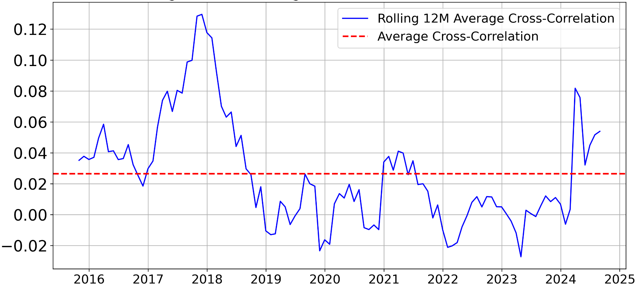
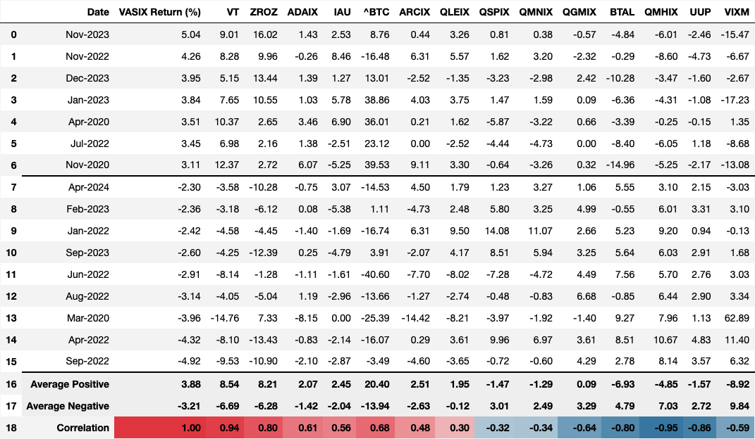
Rolling Correlations
& Outlier Analysis
https://github.com/littlecl42/AAA500_FinalProject_CL_IL
Notes:
This slide provides an overview of Rolling Correlations and Outlier Analysis.
The rolling correlation analysis and the correlation summary table help us understand how the relationships between assets change over time and which assets are most effective in reducing overall risk.
The chart above shows the rolling 12-month average cross-correlation of the portfolio over time.
We can see fluctuations in correlation, which highlight the importance of maintaining a flexible investment strategy.
There have been periods, like 2018 and 2024, where average correlations spiked, indicating that most assets were moving together, reducing the benefits of diversification.
During these times, it's especially critical to have assets like market-neutral funds that offer stability and diversification.
The table below provides a summary of average positive and negative correlations between VASIX and other assets.
Notably, ProShares VIX Mid-Term Futures (VIXM) and AGF U.S. Market Neutral Anti-Beta (BTAL) have high negative correlations, emphasizing their value as effective diversifiers within the portfolio.

Slide 11
Portfolio Optimization Strategies
Risk Parity
Balances risk across all assets, resulting in lower concentration and a balanced risk profile.
Minimum Variance
Prioritizes reducing risk in the form of standard deviation, often excluding higher-risk assets and leading to concentration in lower-risk instruments.
Maximum Diversification
Aims to maximize portfolio diversification, including assets with low correlation to reduce risk.
https://github.com/littlecl42/AAA500_FinalProject_CL_IL
Notes:
Lets discuss the different Portfolio Optimization Strategies we have considered for designing a balanced investment portfolio.
Each of these three strategies serves a unique purpose in managing risk and enhancing return potential.
First, we have Risk Parity. The Risk Parity approach aims to balance risk evenly across all assets in the portfolio.
This results in a lower concentration in any one asset, creating a more balanced risk profile.
By ensuring that each asset contributes an equal amount of risk, we can reduce the likelihood that a single asset dominates the portfolio, thus enhancing overall stability.
The next approach is Minimum Variance.
This strategy is focused on minimizing risk, specifically in terms of standard deviation.
By prioritizing lower-risk assets, Minimum Variance portfolios tend to exclude higher-risk components, which leads to a concentration in safer instruments.
This makes the portfolio less volatile, but it may also limit the potential for higher returns.
Essentially, this strategy is all about achieving stability, even if it means sacrificing some growth.
Lastly, we have Maximum Diversification. This strategy aims to achieve the highest possible level of diversification by including assets that have low correlations with each other.
By maximizing diversification, we can effectively reduce the overall portfolio risk, ensuring that various assets respond differently to market events, which helps in smoothing returns and minimizing downturns.
Each of these strategies brings a unique perspective on balancing risk and return, and by evaluating them, we can decide on the optimal approach to best meet your financial objectives while keeping risk in check

Slide 12
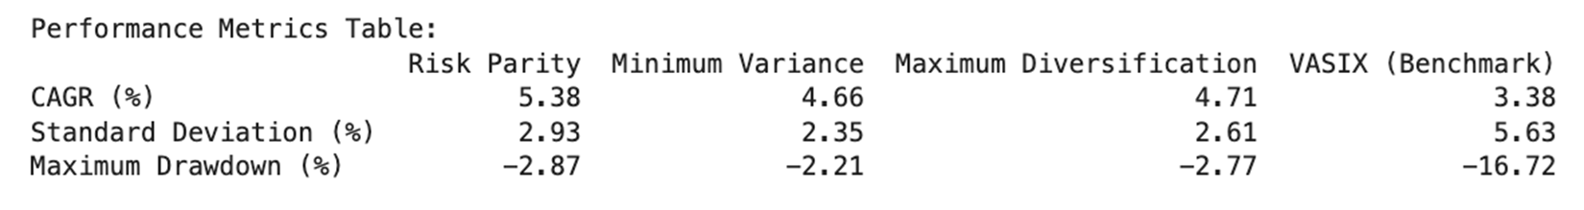
Key Findings
Optimal Strategy
Risk Parity offers the best balance between risk and return.
Performance
Risk Parity shows the highest Compound Annual Growth Rate (CAGR) (5.38%) among the models with a modest maximum drawdown (-2.87%) without excluding any assets (doesn’t “play favorites”)
https://github.com/littlecl42/AAA500_FinalProject_CL_IL
Notes:
This slide summarizes the Key Findings from our portfolio optimization analysis.
We’ll start with the Optimal Strategy.
Based on our analysis, the Risk Parity approach offers the best balance between risk and return.
This strategy effectively spreads risk across all assets, leading to a well-diversified and stable portfolio.
The Risk Parity strategy showed the highest Compound Annual Growth Rate (CAGR) at 5.38% compared to the other models.
This demonstrates its strong growth potential while maintaining risk at manageable levels.
Additionally, Risk Parity had a standard deviation of 2.93%, which is modest and indicates a relatively stable level of volatility.
One of the standout metrics here is the maximum drawdown for Risk Parity, which was -2.87%.
This figure suggests that the strategy has a limited downside during market downturns, helping to protect the portfolio without excluding high-risk assets, unlike Minimum Variance, which tends to concentrate on lower-risk instruments.
Comparatively, the Minimum Variance strategy achieved a CAGR of 4.66% with the lowest standard deviation of 2.35%, making it the least volatile but also more conservative in its growth potential.
Maximum Diversification showed a CAGR of 4.71%, but with a slightly higher drawdown of -2.77%, reflecting a more moderate approach between growth and risk mitigation.
The benchmark—Vanguard LifeStrategy Income Fund (VASIX)—had a CAGR of 3.38% but a much higher standard deviation of 5.63% and a significant drawdown of -16.72%, highlighting the benefits of using optimized strategies over traditional funds.
Risk Parity delivers the highest growth rate while keeping risk levels balanced and drawdowns minimal, making it the optimal strategy for achieving both stability and returns.

Slide 13
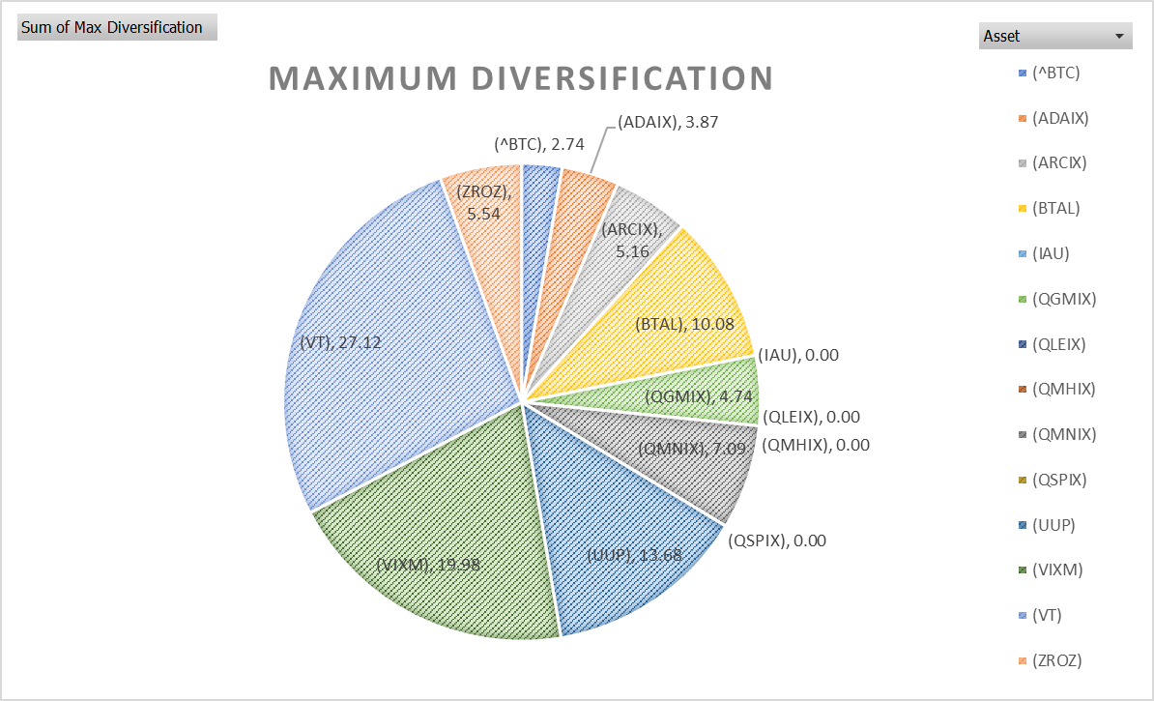
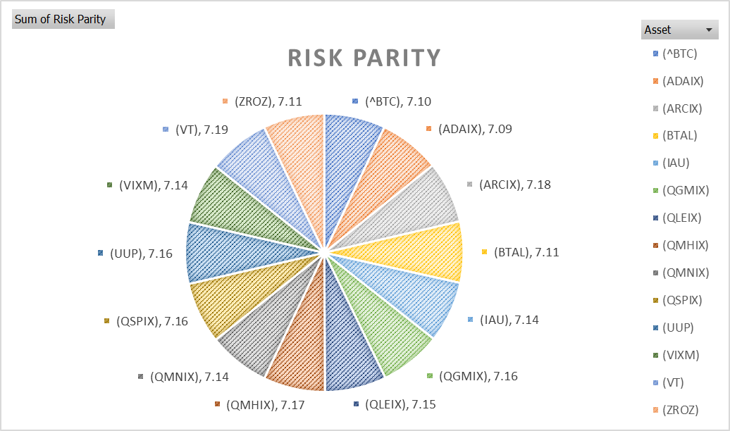
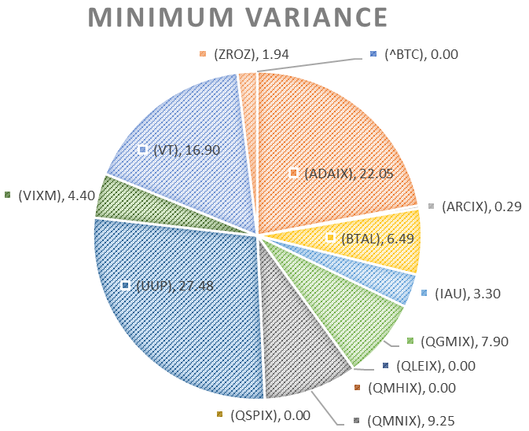
Model Analysis
Limitations
Minimum Variance and Maximum Diversification portfolios exclude too many assets
Maximum Diversification excludes:
iShares Gold Trust (IAU)
AQR Long-Short Equity I (QLEIX)
AQR Style Premia Alternative I (QSPIX)
AQR Managed Futures Strategy HV I (QMHIX)
Risk Parity:
Balances risk across all assets, resulting in lower concentration and a balanced risk profile.
Minimum Variance Excludes:
Bitcoin Market Price USD (ABTC)
AQR Long-Short Equity I (QLEIX)
AQR Style Premia Alternative I (QSPIX)
AQR Managed Futures Strategy HV I (QMHIX)
https://github.com/littlecl42/AAA500_FinalProject_CL_IL
Notes:
In this slide, we’re analyzing the characteristics of three portfolio models: Risk Parity, Minimum Variance, and Maximum Diversification.
Look at how these strategies balance the portfolio and understand their respective limitations.
Starting with Risk Parity: The pie chart on the left shows how Risk Parity distributes risk evenly across all assets.
Each segment is similar in size, which indicates that this model aims to lower concentration risk and maintain a balanced risk profile. By spreading risk evenly, it minimizes the influence of any one asset on the overall portfolio, leading to a more stable performance over time.
Now, let’s discuss minimum variance, shown in the middle pie chart. The goal of Minimum Variance is to minimize risk, which often leads to excluding riskier assets. As a result, some assets, such as Bitcoin (BTC) and certain AQR funds (like AQR Long-Short Equity (QLEIX) and AQR Managed Futures Strategy (QMHIX)), are not included in this model. This leads to a high concentration of fewer, lower-risk instruments. For example, you can see that Vanguard Total World Stock ETF (VT) takes up a large proportion of the portfolio, while some assets have no allocation. While this model reduces overall volatility, it lacks the inclusion of diverse assets, limiting growth potential.
For Maximum Diversification, represented by the pie chart on the right, the focus is on maximizing diversification by including assets with low correlations. However, this approach also has its limitations. Some assets, like iShares Gold Trust (IAU) and AQR Style Premia Alternative (QSPX), are excluded to reduce correlations and diversify risk. The result is a highly diversified portfolio with more equal allocation than Minimum Variance, but it still excludes several assets that could contribute to overall returns.
The key takeaway from this analysis is that both Minimum Variance and Maximum Diversification tend to exclude too many assets, which can limit the portfolio's ability to fully leverage growth opportunities. In contrast, Risk Parity maintains a broader inclusion, balancing risk across the board, making it the optimal choice for combining stability and growth potential.
Each model has its advantages and drawbacks. However, the Risk Parity strategy strikes the best balance between maintaining broad diversification and minimizing concentration risk, making it the most robust option for achieving consistent returns with controlled risk.

Slide 14
Recommendations
Risk Management
Focus on Risk Parity for balanced risk exposure, while Maximum Diversification can enhance potential returns.
Extend Data Collection
More historical and macroeconomic data would provide robustness to capture different market cycles.
Machine Learning Techniques
Consider clustering assets based on risk-return characteristics for a streamlined portfolio.
https://github.com/littlecl42/AAA500_FinalProject_CL_IL
Notes:
We’d like to share some key Recommendations based on our findings. These recommendations are designed to help enhance the robustness and effectiveness of the portfolio.
First, let’s talk about Risk Management. We recommend focusing on the Risk Parity strategy as the primary approach for balanced risk exposure.
Risk Parity allows for an even distribution of risk across all assets, ensuring that no single asset has an outsized impact on the overall portfolio.
However, to enhance potential returns, we also suggest incorporating elements of Maximum Diversification.
This strategy can provide added growth potential by leveraging low-correlation assets, creating a more diversified portfolio.
Next, we recommend Extending Data Collection. Adding more historical and macroeconomic data to our analysis would provide further robustness.
By incorporating data from different market cycles, we can better capture the full range of possible market conditions, ensuring our portfolio strategies are well-prepared for future economic shifts.
This would allow for a more thorough understanding of asset behavior during periods of market stress and growth.
Lastly, we suggest using Machine Learning Techniques. By considering methods like clustering assets based on their risk-return characteristics, we could create a more streamlined portfolio.
Machine learning algorithms can help identify hidden patterns and relationships within the data, allowing for more sophisticated asset allocation strategies that are optimized for both risk and return.
These recommendations are aimed at creating a resilient, well-diversified portfolio that can adapt to varying market conditions while maximizing return potential.

Slide 15
Conclusion
Balanced Approach
Using Risk Parity with a mix of high and low-risk assets provides robust returns with controlled volatility.
Client Alignment
The recommended portfolio strategy aligns with client goals for moderate risk and returns exceeding 4%.
https://github.com/littlecl42/AAA500_FinalProject_CL_IL
Notes:
To wrap up our presentation, let’s summarize our key points.
First, we advocate for a Balanced Approach. We can achieve robust returns while maintaining controlled volatility by utilizing the Risk Parity strategy with a mix of high-risk and low-risk assets This combination ensures that we capitalize on growth opportunities while mitigating downside risk, thereby achieving a balanced performance over time.
Secondly, it is crucial to highlight Client Alignment. The recommended portfolio strategy has been designed to perfectly align with the client’s financial goals—specifically, a moderate risk level with returns exceeding 4%.
By incorporating diverse asset classes and using advanced strategies like Risk Parity, we believe we can meet these objectives effectively while keeping risk within their comfort zone. This balanced strategy aims to give confidence that the financial goals are achievable with a focus on sustainable growth and effective risk management.

Slide 16
Next Steps
Implement the proposed Risk Parity allocation strategy.
Broaden the dataset and leverage advanced statistical models for better predictions.
Regularly review asset performance, especially under changing market conditions, to ensure ongoing alignment with client goals.
https://github.com/littlecl42/AAA500_FinalProject_CL_IL
Notes:
To move forward with our plan, here are the Next Steps we recommend:
First, we’ll begin by implementing the proposed Risk Parity allocation strategy.
This strategy will provide balanced risk exposure across the portfolio, ensuring that each asset contributes proportionally to the overall risk.
Next, we plan to broaden the dataset and leverage advanced statistical models to enhance our predictions.
By incorporating more historical data and additional macroeconomic indicators, we can improve the accuracy of our models, which will help us better anticipate future market movements and optimize the portfolio accordingly.
Finally, we will regularly review asset performance, especially as market conditions change, to ensure ongoing alignment with the client’s financial goals.
This will allow us to make timely adjustments, keeping the portfolio on track to meet objectives while managing risk effectively.
These steps are crucial to maintaining a well-balanced and adaptive portfolio that remains aligned with the client’s investment strategy and goals.

Slide 17
Division of Labor
Week 3 | Form Teams, Choose Project/Dataset | Ian/Carrie
 | In-Person Meeting, Create Collab Files/Folder | Ian/Carrie
 | Formulate Research Questions | Ian
 | Generate Business Objective | Carrie
 | Review Dataset, Generate Data Descriptives | Carrie
Week 4 | Outline Data Analysis Plan | Ian
 | Develop Preliminary Models | Ian/Carrie
 | In-Person Meeting, Analyze Models | Ian/Carrie
 | Develop Conclusions and Recommendations | Ian/Carrie
 | Submit Final Project Check-in | Ian
Week 5 | Draft Report | Ian
 | Draft Presentation | Carrie
 | In-Person Meeting, Review Drafts | Ian/Carrie
Week 6 | Review Tables/Figures/Visualizations | Ian/Carrie
 | Review References/Sources/Links | Ian/Carrie
 | In-Person Meeting - Presentation Review | Ian/Carrie
Week 7 | Finalize Presentation | Ian
 | Record Project Presentation | Ian/Carrie
 | Finalize Final Report | Carrie
 | Finalize GitHub | Carrie
 | Submit Final Report /Presentation | Ian
https://github.com/littlecl42/AAA500_FinalProject_CL_IL
Notes:
Now for our division of labor for the project.
Teams were assigned in week two. We began week three by communicating on Slack and setting up our first meeting. We came into the 1st meeting with dataset suggestions and direction for the project.
We discussed and selected our dataset at our 1st meeting. In the meeting, Ian was chosen as “Team Leader” and was responsible for submitting any singular forms and reports to Canvas.
Our collaboration folders were set up with Ian taking the lead by creating a Google Share Drive, and I, in turn, established and maintained our GitHub Repository.
We met in person each week in the library group study spaces, which allowed us to work back and forth, share, and compare our progress throughout the project. Additionally, there was back-and-forth communication via Slack.
Ian drafted the Technical Report, which I reviewed and finalized. I then created the presentation based on the draft.
Ian reviewed the draft presentation and made changes where warranted.
I finalized the report, which included outputting our Jupyer notebooks to PDF and combining them into the final report in Adobe.
After recording this presentation, Ian will submit the final report and finalized presentation and upload the recorded presentation into Canvas. I will ensure the final push to GitHub so that the final report and presentation, as submitted, are up to date.

Slide 18
The Risky Business of Safe Investing Optimizing Conservative Portfolios
FA24-AAI-500 FINAL PROJECT
PRESENTED BY CARRIE LITTLE
AND IAN LUCAS
https://github.com/littlecl42/AAA500_FinalProject_CL_IL
Notes:
This concludes our presentation. Thank you for your attention to our presentation on The Risky Business of Safe Investing Optimizing Conservative Portfolios

Slide 19
Backup Slides Data Analytics and Modeling
Monthly Return Time Series Plots
Raw Return Histograms with Fitted Probability Distributions
QQ-Plots
Rolling 36-Month Means, Standard Deviations, and Risk-Adjusted Returns
Asset Risk-Return Characteristics
Model Analysis - Portfolio Weights Table
Model Analysis - Risk Contribution Table
Model Analysis - Performance Metrics Table
Model Analysis - Annual Return Table
Model Analysis - Regression Results Table
Model Analysis - Fama French Factors
Monte Carlo Analysis Table (36-months, 10,000 iterations)
Quantitative Goodness of Fit Tests AIC, BIC, K-S
Box and Whisker Plot
https://github.com/littlecl42/AAA500_FinalProject_CL_IL

Slide 20
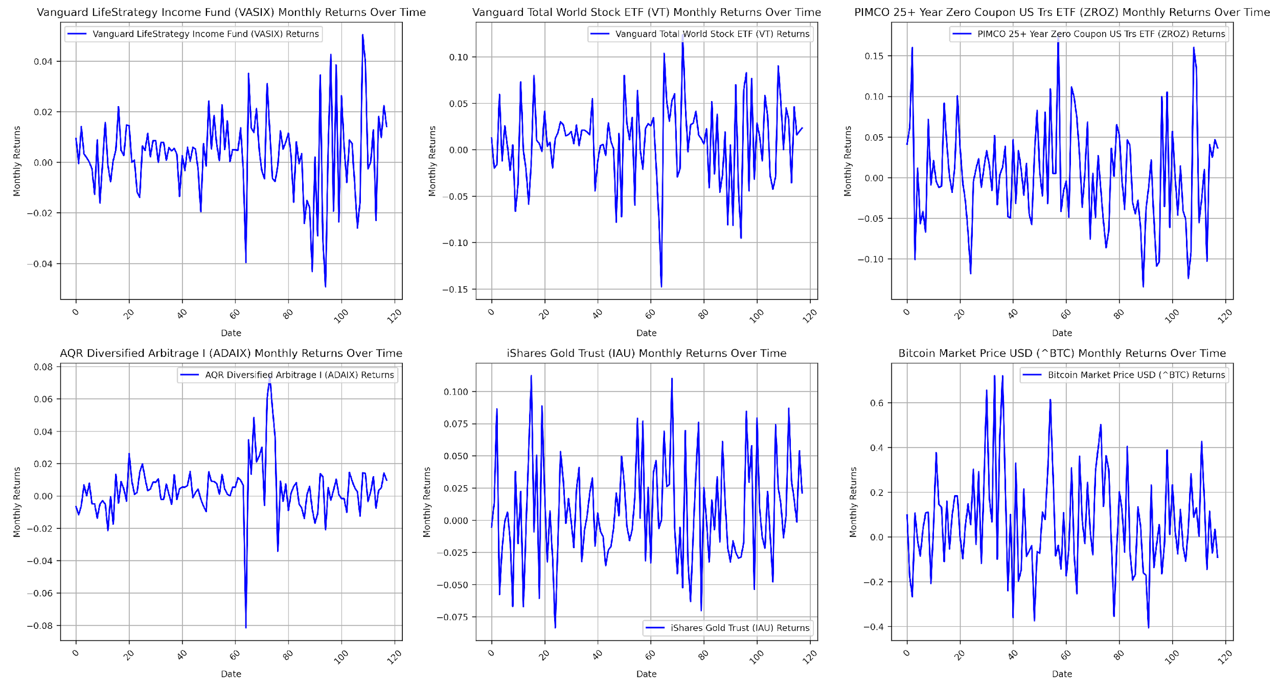
Monthly Return Time Series Plots page 1 of 3
https://github.com/littlecl42/AAA500_FinalProject_CL_IL
Notes:
Monthly Return Time Series Plots
Vanguard LifeStrategy Income Fund (VASIX)
The returns exhibit relatively low volatility throughout the time period, with no major spikes or extreme changes. The performance has been steady, fitting its conservative nature.
Vanguard Total World Stock ETF (VT)
The plot shows higher volatility compared to VASIX, with several notable upward and downward spikes. This is consistent with its equity exposure across global markets.
PIMCO 25+ Year Zero Coupon US Treasury ETF (ZROZ)
The returns show significant fluctuations, reflecting the high sensitivity of long-duration bonds to changes in interest rates. Peaks and troughs are evident, particularly in response to macroeconomic shifts.
AQR Diversified Arbitrage I (ADAIX)
The plot shows relatively stable returns with one significant negative spike around the midpoint of the time series, indicating an event-driven risk that impacted returns significantly at that point.
iShares Gold Trust (IAU)
Monthly returns display moderate volatility with several noticeable spikes, indicating sensitivity to broader economic factors and market uncertainty, which is typical for gold as a safe-haven asset.
Bitcoin Market Price USD (^BTC)
Bitcoin's returns are extremely volatile, with both significant positive and negative spikes. The return pattern demonstrates high risk and potential high reward, making it a distinct asset compared to others in this dataset.

Slide 21
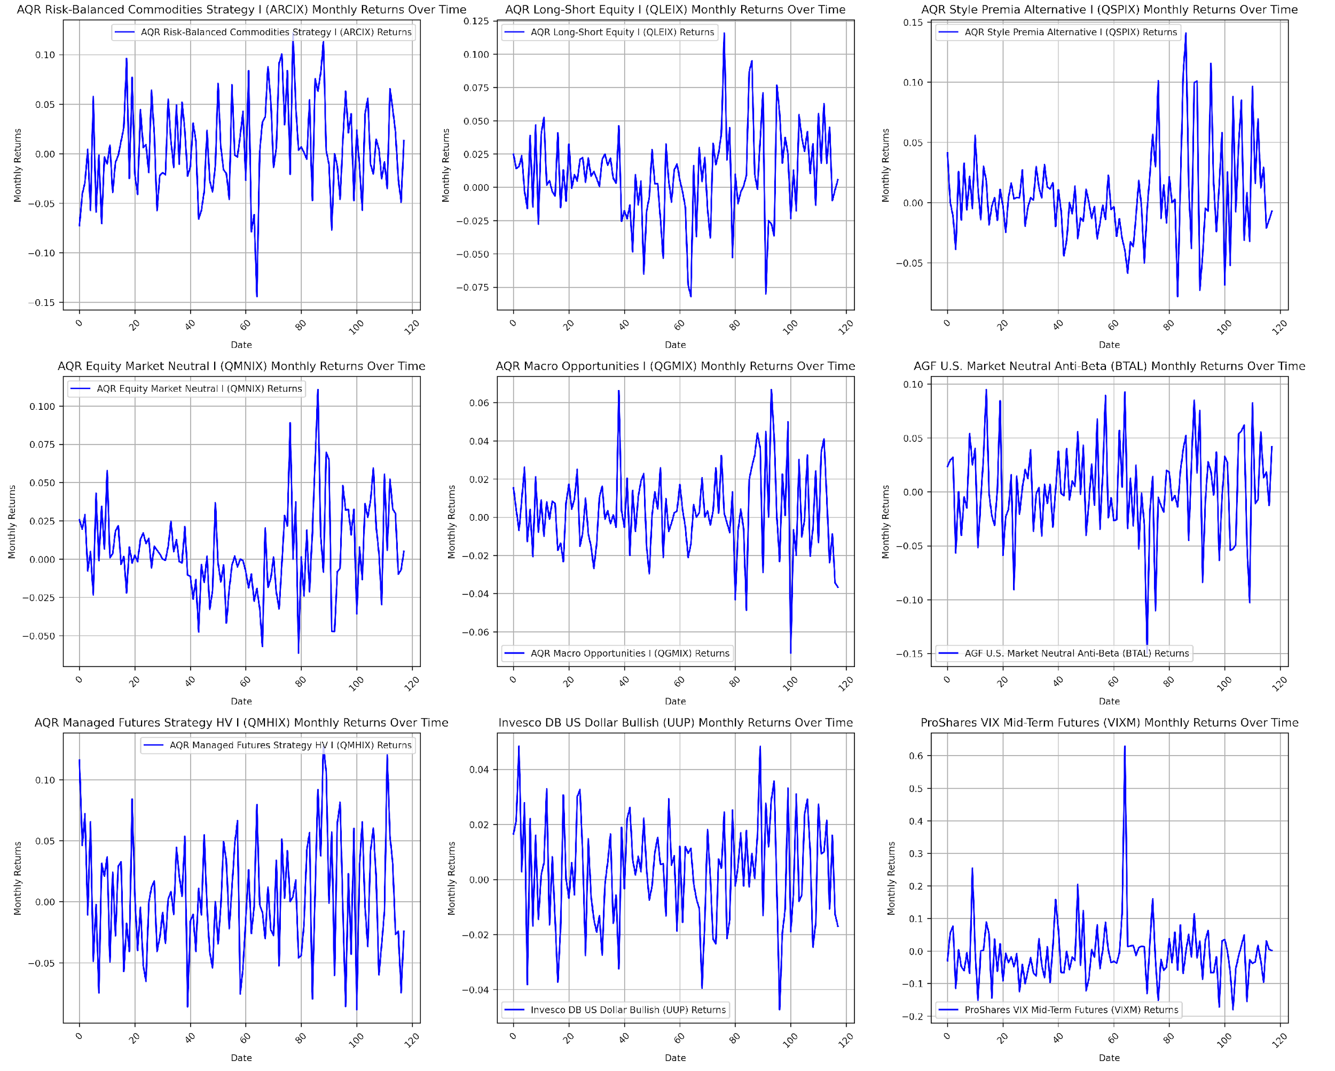
Monthly Return Time Series Plots page 2 of 3
https://github.com/littlecl42/AAA500_FinalProject_CL_IL
Notes:
Monthly Return Time Series Plots
AQR Risk-Balanced Commodities Strategy I (ARCIX)
The returns display moderate volatility, with a number of significant downward and upward movements, likely reflecting commodity price swings and their impact on the fund's strategy.
AQR Long-Short Equity I (QLEIX)
Returns are generally stable, with some fluctuations, suggesting that the long-short strategy mitigates extreme movements typically seen in traditional equity funds.
AQR Style Premia Alternative I (QSPIX)
Returns show significant fluctuations, with occasional sharp negative movements, indicating exposure to specific risk factors or market dislocations.
AQR Equity Market Neutral I (QMNIX)
The plot shows relatively stable returns with minimal fluctuation, supporting the market-neutral strategy's goal of reducing systematic risk.
AQR Macro Opportunities I (QGMIX)
The plot displays significant return fluctuations, both positive and negative, suggesting sensitivity to macroeconomic events and the impact of tactical positioning.
AGF U.S. Market Neutral Anti-Beta (BTAL)
The returns show moderate volatility, with some noticeable negative movements, indicating occasional drawdowns despite a generally defensive stance.

Slide 22
Monthly Return Time Series Plots page 3 of 3
https://github.com/littlecl42/AAA500_FinalProject_CL_IL
Notes:
Monthly Return Time Series Plots
AQR Managed Futures Strategy HV I (QMHIX)
Returns display considerable volatility, with several sharp spikes, indicating the high-risk nature of managed futures strategies that thrive on market trends.
Invesco DB US Dollar Bullish (UUP)
Returns are relatively stable with moderate fluctuations, reflecting the currency fund's performance in response to the strength of the U.S. dollar against other currencies.
ProShares VIX Mid-Term Futures (VIXM)
The plot shows several sharp spikes, particularly during market turmoil, which is consistent with the nature of VIX-related products that tend to rise in times of market stress.

Slide 23
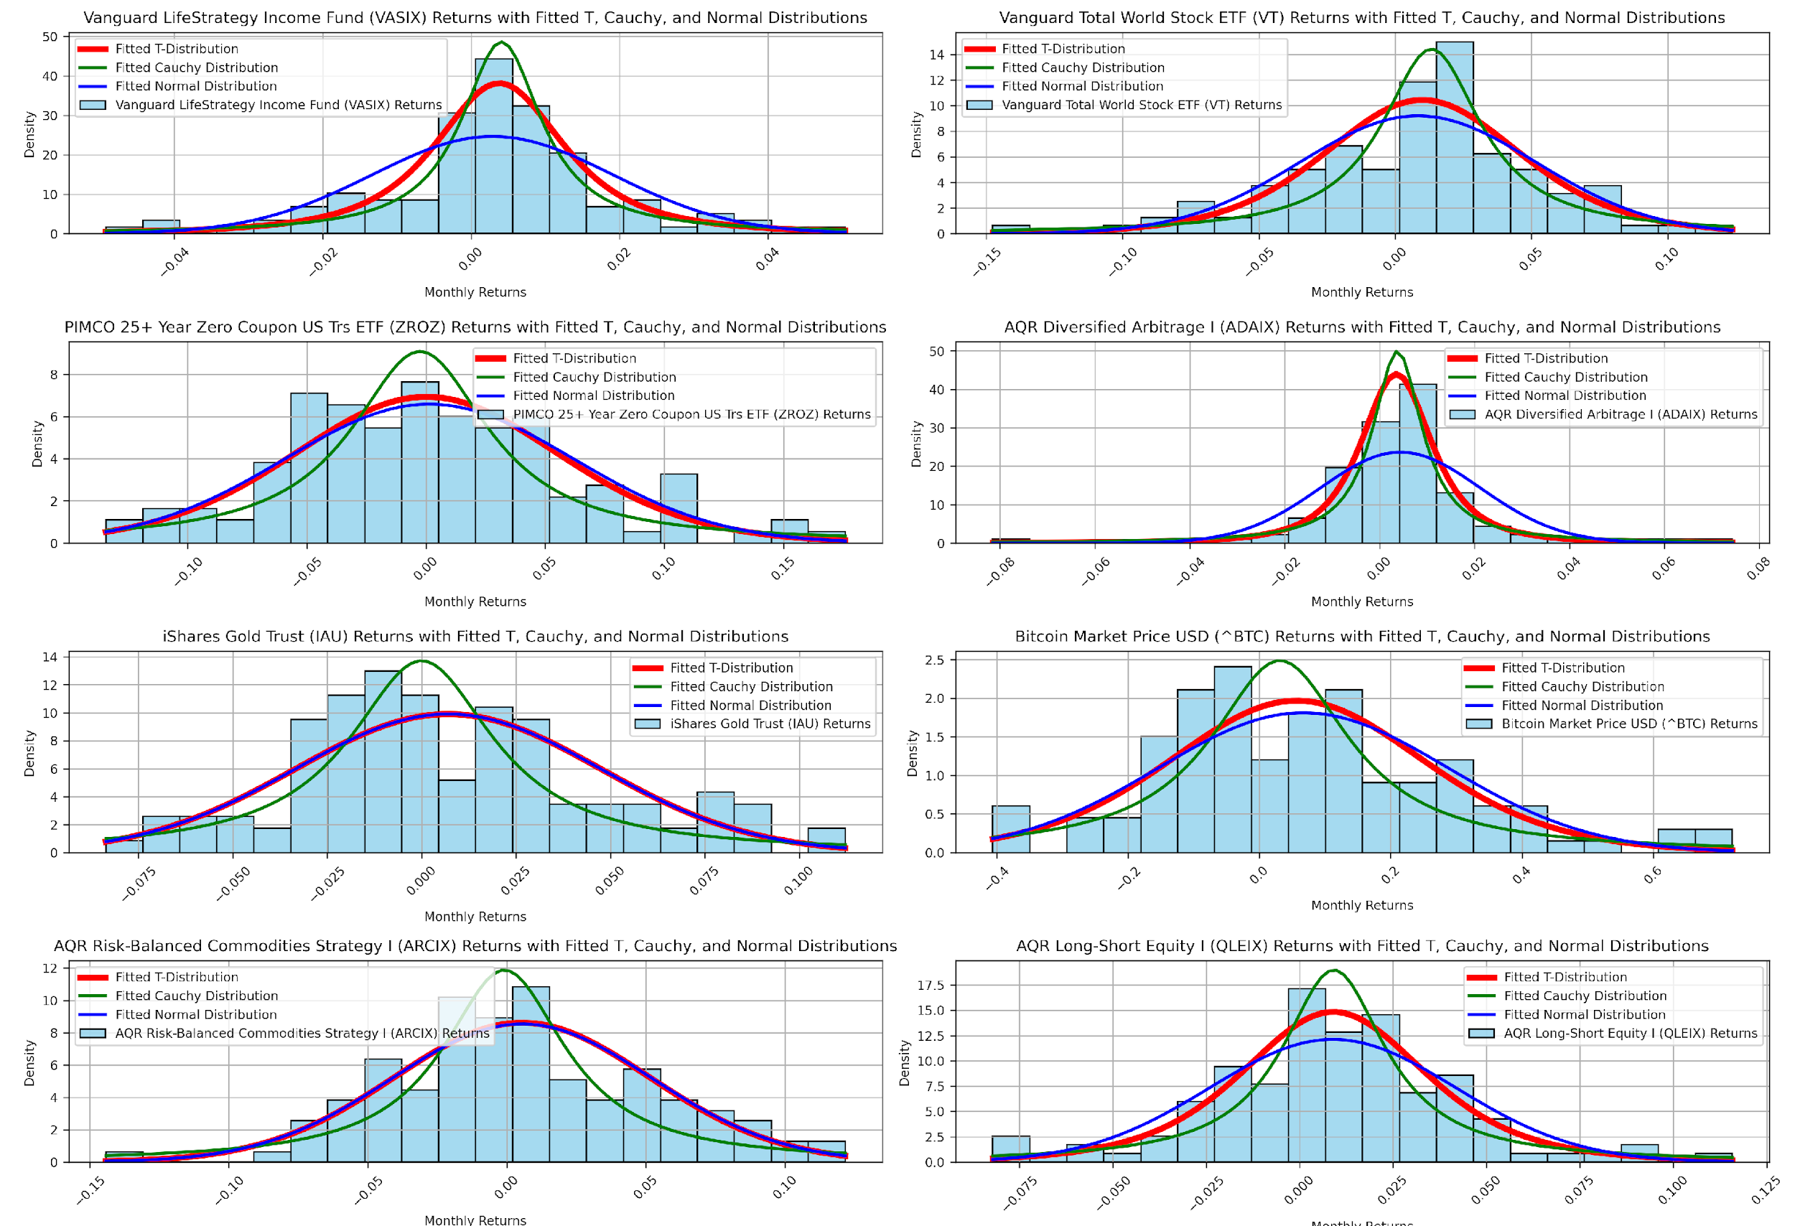
Raw Return Histograms page 1 of 4
with Fitted Probability Distributions
T, Cauchy, and Normal distributions
https://github.com/littlecl42/AAA500_FinalProject_CL_IL
Notes:
Raw Return Histograms with Fitted Probability Distributions
T, Cauchy, and Normal distributions
Vanguard LifeStrategy Income Fund (VASIX)
The histogram is centered and symmetric, with low tails. The fitted T distribution (red) captures the kurtosis better than the normal distribution (green).
The Cauchy distribution (blue) overestimates the tails, suggesting VASIX has a lower tail risk than a typical Cauchy process.
Vanguard Total World Stock ETF (VT)
The histogram is fairly symmetric with heavier tails compared to a normal distribution. The T distribution captures this heavy-tailed nature well, while the normal distribution underestimates it.
The Cauchy distribution shows extreme tail coverage that does not align with VT’s empirical return profile.
PIMCO 25+ Year Zero Coupon US Treasury ETF (ZROZ)
The histogram exhibits a moderate skew and some heavy tails, consistent with long-duration bond risk.
The T distribution fits the tails more accurately than the normal distribution, underestimating extreme return behavior.
AQR Diversified Arbitrage I (ADAIX)
The histogram is approximately symmetric with moderate kurtosis.
The T distribution fits the data well, while the Cauchy distribution overestimates tail probability.

Slide 24
Raw Return Histograms page 2 of 4
with Fitted Probability Distributions
T, Cauchy, and Normal distributions
https://github.com/littlecl42/AAA500_FinalProject_CL_IL
Notes:
Raw Return Histograms with Fitted Probability Distributions
T, Cauchy, and Normal distributions
iShares Gold Trust (IAU)
The histogram is moderately skewed to the right, and the tails are heavier than the normal distribution can accommodate.
The T distribution provides a better fit, particularly in accounting for higher frequencies in the tails.
Bitcoin Market Price USD (^BTC)
The histogram displays significant kurtosis, with extreme tails on both sides.
The Cauchy distribution aligns better with the extreme tail behavior than the T or normal distribution, which underestimate the frequency of large movements.
AQR Risk-Balanced Commodities Strategy I (ARCIX)
The histogram exhibits a moderate degree of skewness and kurtosis.
The T distribution provides the most appropriate fit, with the normal distribution significantly underestimating the tail events.
AQR Long-Short Equity I (QLEIX)
The histogram is centered with moderate tail risk.
The T distribution captures the tail behavior better than the normal, with the Cauchy again overestimating risk.

Slide 25
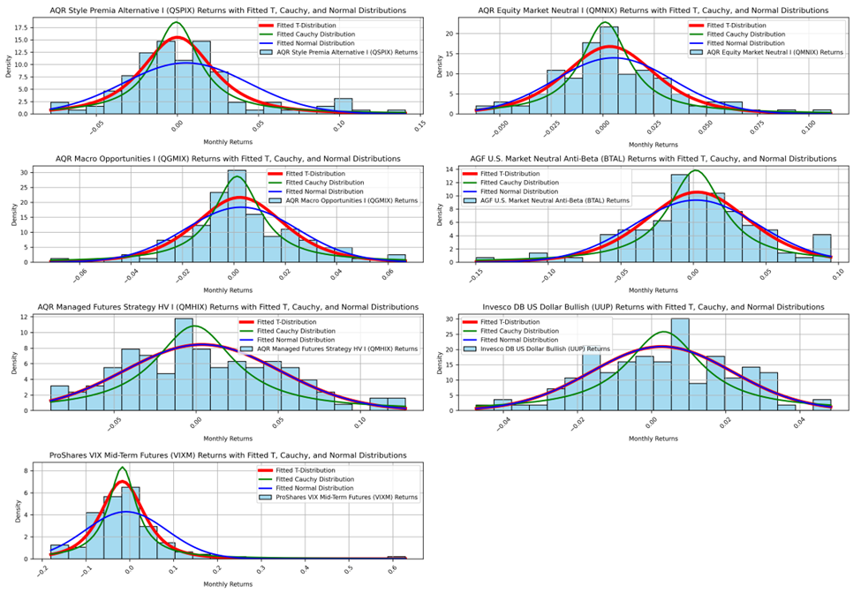
Raw Return Histograms page 3 of 4
with Fitted Probability Distributions
T, Cauchy, and Normal distributions
https://github.com/littlecl42/AAA500_FinalProject_CL_IL
Notes:
Raw Return Histograms with Fitted Probability Distributions
T, Cauchy, and Normal distributions
AQR Style Premia Alternative I (QSPIX)
The histogram shows a slight positive skew and moderate kurtosis.
The T distribution closely follows the empirical distribution, while the normal distribution fails to adequately capture the tail thickness.
AQR Equity Market Neutral I (QMNIX)
The histogram is approximately normal with mild skewness.
Both T and normal distributions provide a reasonable fit, while the Cauchy overstates tail risks.
AQR Macro Opportunities I (QGMIX)
The histogram is heavily skewed with a high peak and some significant outliers.
The T distribution fits the main distribution well but underestimates the extreme outliers, where the Cauchy distribution provides better tail coverage.
AGF U.S. Market Neutral Anti-Beta (BTAL)
The histogram shows moderate negative skewness and excess kurtosis.
The T distribution provides a good approximation for both skew and kurtosis, with the normal distribution missing the heavier tails.

Slide 26
Raw Return Histograms page 4 of 4
with Fitted Probability Distributions
T, Cauchy, and Normal distributions
https://github.com/littlecl42/AAA500_FinalProject_CL_IL
Notes:
Raw Return Histograms with Fitted Probability Distributions
T, Cauchy, and Normal distributions
AQR Managed Futures Strategy HV I (QMHIX)
The histogram has a slight positive skew and noticeable kurtosis.
The T distribution matches the data well, while the normal distribution underestimates tail frequencies.
Invesco DB US Dollar Bullish (UUP)
The histogram is relatively symmetric, though there is noticeable kurtosis.
The T distribution provides a better fit than the normal distribution for the higher frequency of tail returns.
ProShares VIX Mid-Term Futures (VIXM)
The histogram has heavy tails and significant kurtosis.
The Cauchy distribution matches extreme tail frequencies better, indicating a higher probability of large movements than the normal or T distributions predict.

Slide 27
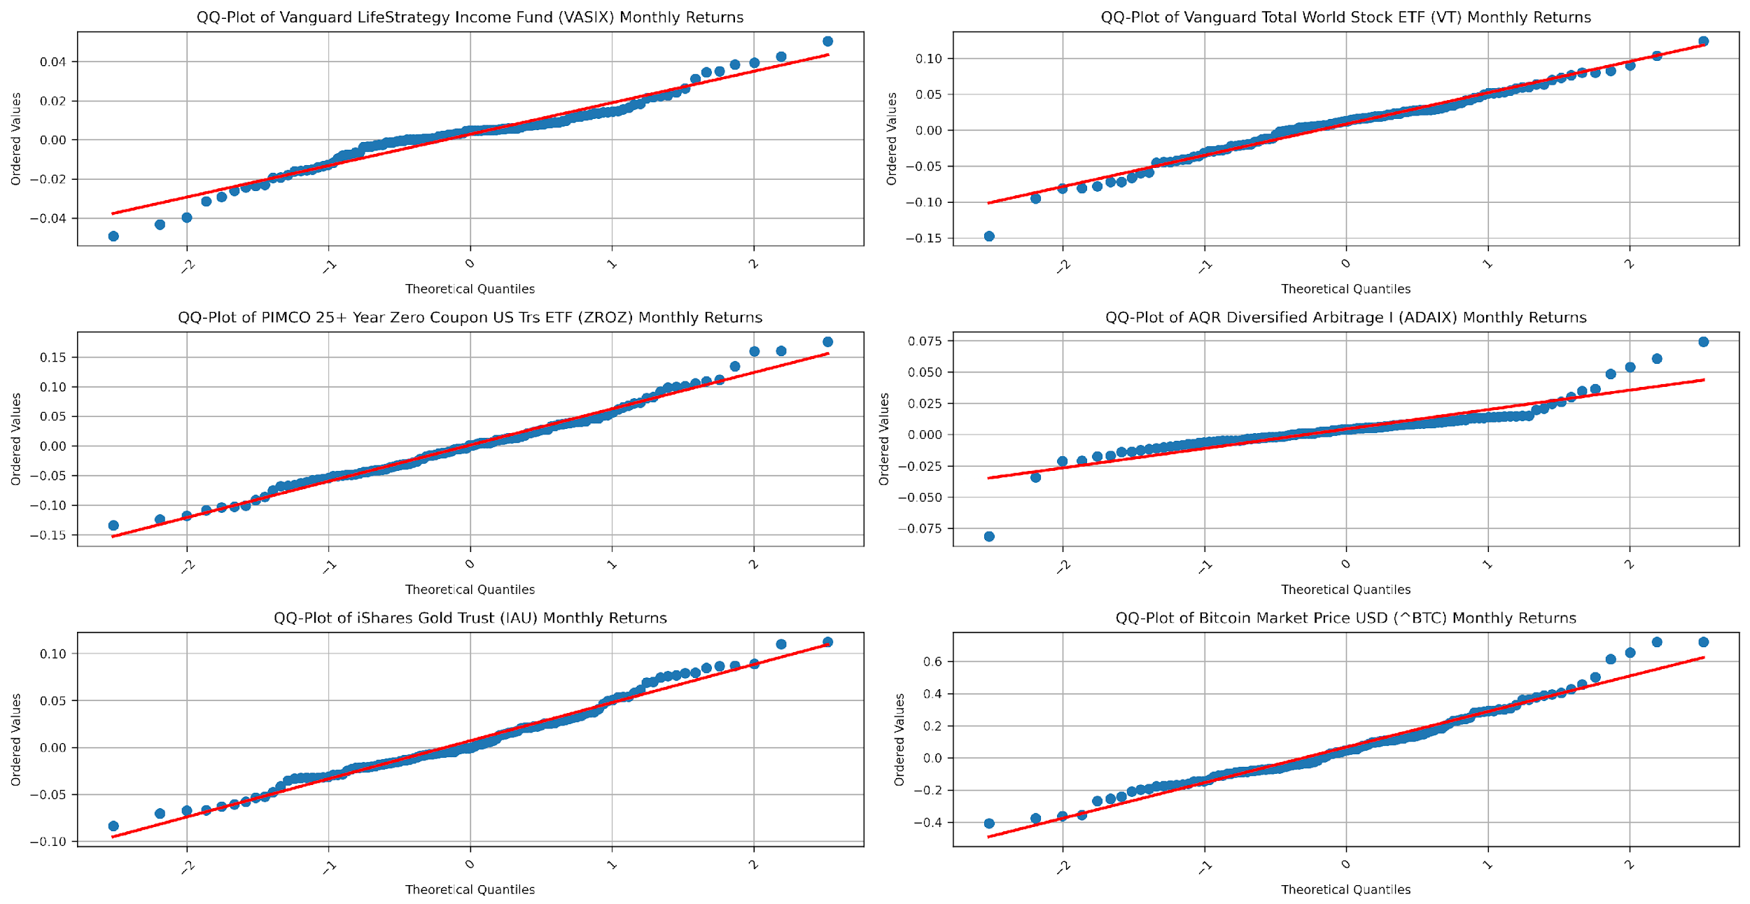
QQ-Plots page 1 of 3
https://github.com/littlecl42/AAA500_FinalProject_CL_IL
Notes:
QQ-Plots
Vanguard LifeStrategy Income Fund (VASIX)
The QQ plot shows that the points largely follow the theoretical line, except for slight deviations in the tails.
This suggests that VASIX is approximately normally distributed in the central portion, with some heavier tails, aligning with the previous interpretation.
Vanguard Total World Stock ETF (VT)
The QQ plot reveals that the tails deviate from the normal line, with more significant deviations at the extremes.
This reinforces the earlier observation that VT has heavy tails, indicating that a normal distribution is insufficient for capturing the full range of return behavior.
PIMCO 25+ Year Zero Coupon US Treasury ETF (ZROZ)
The plot shows deviations from the normal line, particularly in the lower and upper extremes, suggesting heavier tails.
This observation is consistent with the previous analysis, where the T distribution fit better than the normal.
AQR Diversified Arbitrage I (ADAIX)
The points deviate slightly at the tails, indicating moderate kurtosis.
The T distribution remains a suitable fit, with the normal distribution underestimating the tails.
iShares Gold Trust (IAU)
The QQ plot indicates noticeable deviations from the theoretical line in the tails, indicating heavier tails than a normal distribution would suggest. This supports the previous analysis, where the T distribution provided a better fit.
Bitcoin Market Price USD (^BTC)
The plot shows extreme deviations in upper and lower tails, confirming very heavy tails and high kurtosis.
This aligns with the earlier finding that the Cauchy distribution fits Bitcoin’s returns better due to the presence of extreme return events.

Slide 28
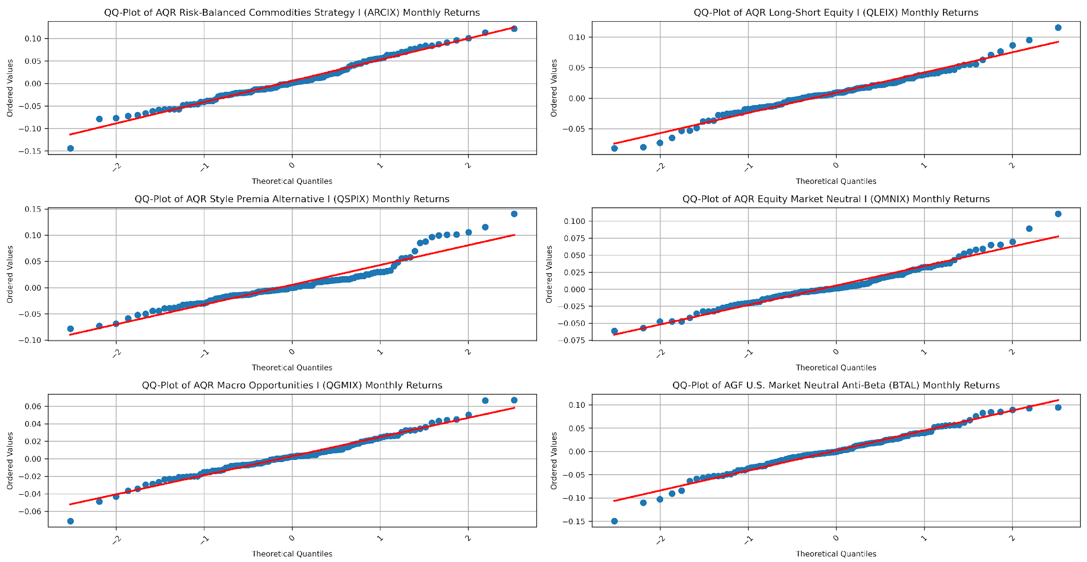
QQ-Plots page 2 of 3
https://github.com/littlecl42/AAA500_FinalProject_CL_IL
Notes:
QQ-Plots
AQR Risk-Balanced Commodities Strategy I (ARCIX)
The QQ plot displays deviations in the tails, indicating that a normal distribution does not capture extreme events well.
The T distribution is the best choice based on the observed heavy tails.
AQR Long-Short Equity I (QLEIX)
The points follow the theoretical line reasonably closely, with slight deviations in the tails.
This suggests moderate tail risk, supporting the previous observation that a T distribution provides a reasonable fit.
AQR Style Premia Alternative I (QSPIX)
The QQ plot shows deviations from the normal line, particularly in the upper tails, indicating heavier tail behavior.
This supports the earlier conclusion that the T distribution fits the return distribution better than the normal.
AQR Equity Market Neutral I (QMNIX)
The points follow the theoretical line relatively closely, with only slight deviations in the tails.
Both the T and normal distributions could be reasonable fits, although the T distribution provides a slight improvement in capturing the tail behavior.
AQR Macro Opportunities I (QGMIX)
The QQ plot displays notable deviations at the extremes, indicating heavier tails than the normal distribution can accommodate.
This supports the use of the T distribution over the normal for fitting QGMIX returns.
AGF U.S. Market Neutral Anti-Beta (BTAL)
The QQ plot shows noticeable negative skewness, with points deviating below the line at the lower end.
This confirms the earlier observation of negative skewness and heavier tails, suggesting the T distribution as a better fit.

Slide 29
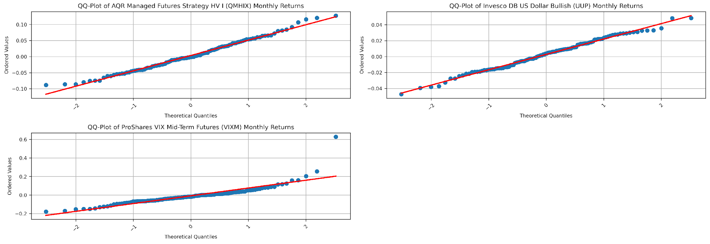
QQ-Plots page 3 of 3
https://github.com/littlecl42/AAA500_FinalProject_CL_IL
Notes:
QQ-Plots
AQR Managed Futures Strategy HV I (QMHIX)
The plot shows moderate deviations from the normal line in the tails, indicating heavier tails.
The T distribution remains the best fit based on the tail behavior observed.
Invesco DB US Dollar Bullish (UUP)
The QQ plot shows slight deviations from the normal line at the tails, but the overall fit is close.
This supports the earlier conclusion that both the T and normal distributions could fit reasonably well, with the T providing a slight edge in capturing tail risk.
ProShares VIX Mid-Term Futures (VIXM)
The QQ plot shows significant deviations in the tails, indicating extreme tail behavior.
The Cauchy distribution is likely a better fit due to the pronounced tail deviations, aligning with previous observations.

Slide 30
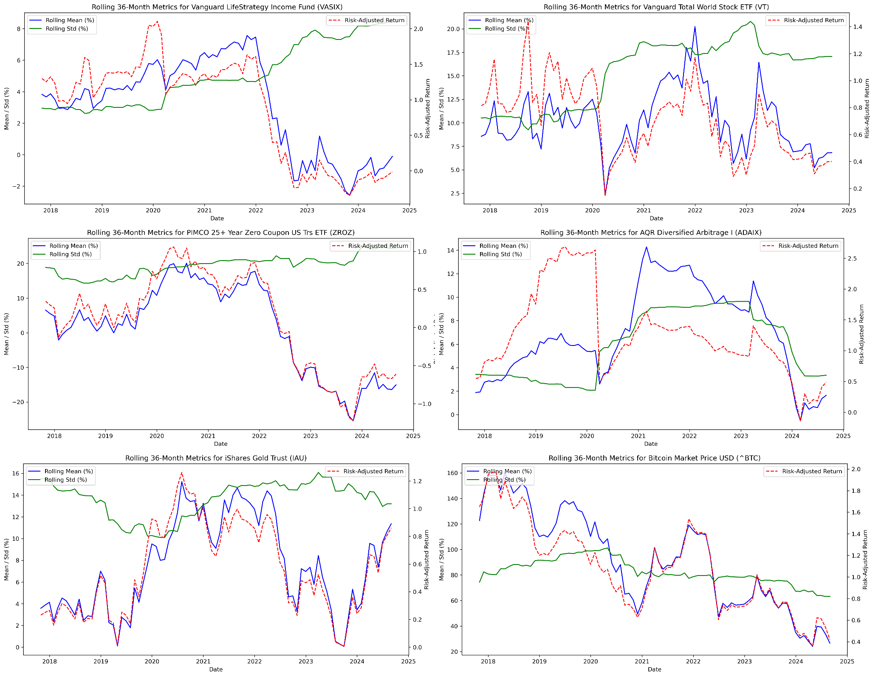
Rolling 36-Month Means, Standard Deviations,
and Risk-Adjusted Returns page 1 of 4
https://github.com/littlecl42/AAA500_FinalProject_CL_IL
Notes:
Rolling 36-Month Means, Standard Deviations, and Risk-Adjusted Returns
Vanguard LifeStrategy Income Fund (VASIX)
The rolling mean returns have gradually declined since 2021, indicating consistent underperformance in the current interest rate environment. This suggests that VASIX may not be as effective in capturing recent market opportunities, reflecting its conservative nature. The rolling standard deviation increased significantly starting in 2022, reflecting a shift in the risk profile due to changing interest rates and economic uncertainty. The rolling risk-adjusted returns have trended downwards since 2021, indicating underperformance compared to the volatility experienced. This suggests that VASIX’s conservative allocation struggled to provide meaningful returns amid increased market turbulence.
Vanguard Total World Stock ETF (VT)
The rolling mean increased significantly in 2021, peaking around the middle of the year before declining in 2023. This implies that VT captured equity market gains during the post-pandemic recovery but suffered as markets faced increased volatility and tightening monetary conditions in 2022-2023. The standard deviation remained relatively constant but increased during market turmoil. This aligns with VT’s exposure to global equity risk, leading to increased volatility during crises. Risk-adjusted returns have been highly volatile, peaking in 2021 but dropping after that, which reflects both high returns and high volatility associated with global equity markets.
PIMCO 25+ Year Zero Coupon US Treasury ETF (ZROZ)
The rolling mean returns peaked in 2020-2021 but declined sharply afterward, reflecting the impact of rising interest rates on long-duration bonds. This emphasizes ZROZ's interest rate sensitivity and explains its weak performance when interest rates increased.
Volatility increased significantly starting in 2021, indicating increased risk due to interest rate hikes. This is consistent with ZROZ's high sensitivity to rate changes. The risk-adjusted returns have declined sharply since 2021, reflecting the adverse impact of rising interest rates. ZROZ has underperformed due to its vulnerability to duration risk.
AQR Diversified Arbitrage I (ADAIX)
The rolling mean returns rose steadily into 2021, benefiting from a favorable arbitrage environment, but dropped in the last couple of years. This suggests that conditions became less conducive to arbitrage opportunities, likely driven by increased market volatility. Rolling standard deviation remained stable for most of the period but spiked around 2021. This shows that ADAIX faced episodic increases in volatility, likely due to temporary market dislocations.
Showed relatively stable and improving risk-adjusted returns, suggesting effective risk management and a favorable market environment in recent years.

Slide 31
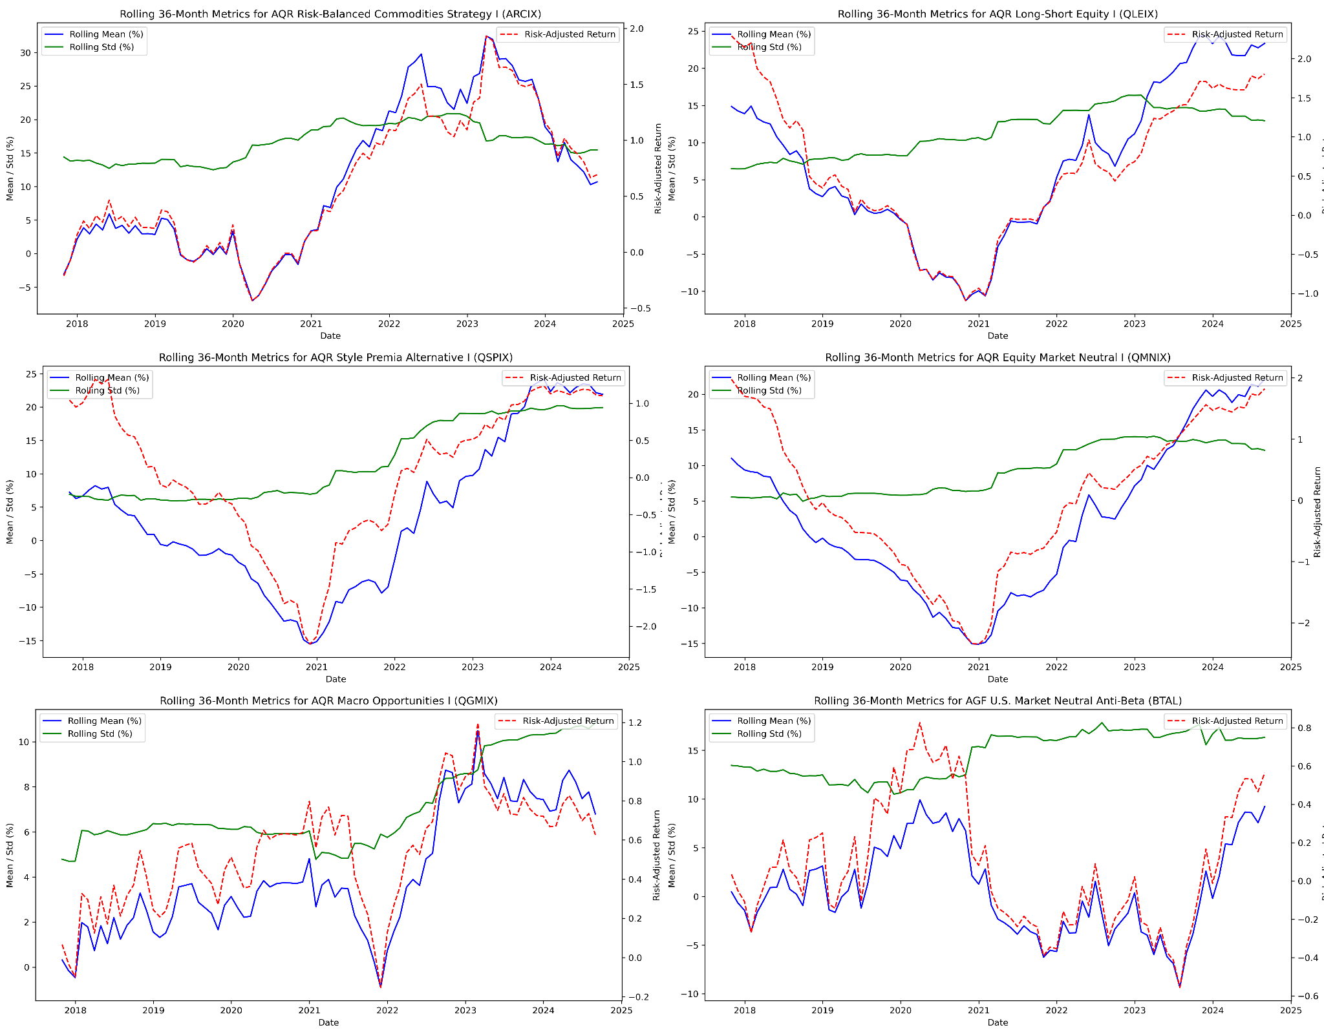
Rolling 36-Month Means, Standard Deviations,
and Risk-Adjusted Returns page 2 of 4
https://github.com/littlecl42/AAA500_FinalProject_CL_IL
Notes:
Rolling 36-Month Means, Standard Deviations, and Risk-Adjusted Returns
iShares Gold Trust (IAU)
The rolling mean fluctuates widely, peaking during times of market uncertainty. Gold’s role as a haven becomes apparent, with improved performance during economic distress, making it a useful diversifier.
Bitcoin Market Price USD (^BTC)
The rolling mean peaked in 2020-2021, benefiting from the bull market, but has declined sharply as market sentiment shifted. This behavior highlights Bitcoin’s sensitivity to risk appetite, contributing positively during market rallies but suffering heavily during downturns. The rolling standard deviation decreased but remained extremely high, highlighting persistent volatility even during quieter periods. This is consistent with Bitcoin's highly speculative nature.
Rolling risk-adjusted returns have been consistently negative since mid-2021, indicating that the high volatility of Bitcoin has outweighed its return potential in recent market conditions.
AQR Risk-Balanced Commodities Strategy I (ARCIX)
The rolling mean improved significantly in 2021, reflecting strong commodity markets, but has moderated since then. This illustrates its ability to perform well during inflationary periods but with vulnerability to commodity market cycles.
AQR Long-Short Equity I (QLEIX)
It showed substantial improvements in its rolling means post-2021, indicating that this strategy captured specific market opportunities or factor premiums effectively during the post-pandemic period. Volatility rose gradually over time, reflecting exposure to systematic risks. The steady increase highlights the evolving nature of factor-based strategies and macro-opportunities in varying market conditions. Showed relatively stable and improving risk-adjusted returns, suggesting effective risk management and a favorable market environment for this strategies in recent years.

Slide 32
Rolling 36-Month Means, Standard Deviations,
and Risk-Adjusted Returns page 3 of 4
https://github.com/littlecl42/AAA500_FinalProject_CL_IL
Notes:
Rolling 36-Month Means, Standard Deviations, and Risk-Adjusted Returns
AQR Style Premia Alternative I (QSPIX)
It showed substantial improvements in its rolling means post-2021, indicating that this strategy effectively captured specific market opportunities or factor premiums during the post-pandemic period. Volatility rose gradually over time, reflecting their exposure to systematic risks. The steady increase highlights the evolving nature of factor-based strategies and macro-opportunities in varying market conditions. Risk-adjusted returns have shown notable recovery since 2021, indicating these strategies benefited from factor premiums and macro-opportunities as the market environment shifted.
AQR Equity Market Neutral I (QMNIX)
Rolling mean returns have steadily increased, particularly in recent years, showing stable performance across different market regimes. This consistency indicates their diversification potential.
AQR Macro Opportunities I (QGMIX)
Rolling mean returns have steadily increased, particularly in recent years, showing stable performance across different market regimes. This consistency indicates their diversification potential. Volatility rose gradually over time, reflecting their exposure to systematic risks. The steady increase highlights the evolving nature of factor-based strategies and macro-opportunities in varying market conditions. Risk-adjusted returns have shown notable recovery since 2021, indicating these strategies benefited from factor premiums and macro-opportunities as the market environment shifted.
AGF U.S. Market Neutral Anti-Beta (BTAL)
The rolling mean has risen steadily since 2021, suggesting that this anti-beta strategy has effectively captured periods of heightened volatility and downturns in equity markets. Showed increasing volatility post-2021, demonstrating responsiveness to increased market trends and disruptions, allowing them to benefit from dislocations but at greater risk. Risk-adjusted returns improved significantly post-2021, reflecting the ability of these strategies to capitalize on increased market volatility. BTAL, in particular, performed well during equity downturns, suggesting a strong diversifying effect.

Slide 33
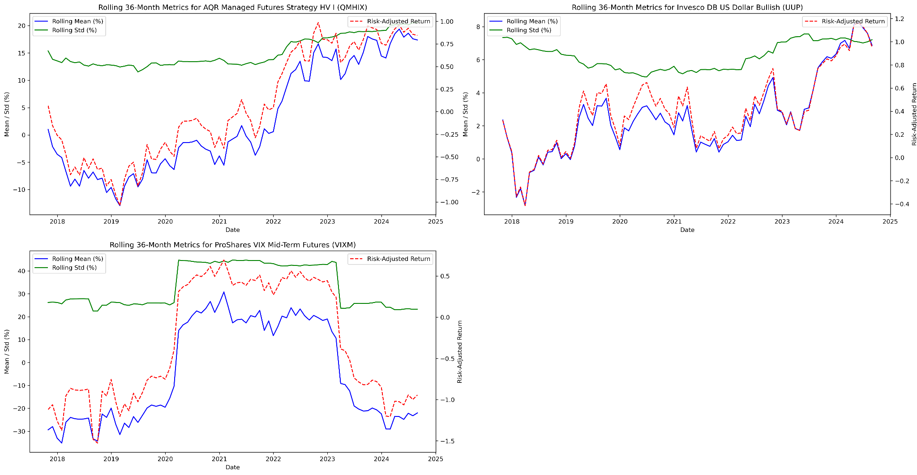
Rolling 36-Month Means, Standard Deviations,
and Risk-Adjusted Returns page 4 of 4
https://github.com/littlecl42/AAA500_FinalProject_CL_IL
Notes:
Rolling 36-Month Means, Standard Deviations, and Risk-Adjusted Returns
AQR Managed Futures Strategy HV I (QMHIX)
Rolling mean returns increased sharply from 2022 onward, benefiting from market dislocations and trends, highlighting the adaptability of managed futures in diverse market environments. Showed increasing volatility post-2021, demonstrating responsiveness to increased market trends and disruptions, allowing them to benefit from dislocations but at greater risk.
Risk-adjusted returns improved significantly post-2021, reflecting the ability of these strategies to capitalize on increased market volatility. BTAL, in particular, performed well during equity downturns, suggesting a strong diversifying effect.
Invesco DB US Dollar Bullish (UUP)
Rolling mean returns have improved notably since 2021, reflecting strength in the U.S. dollar as the Federal Reserve raised interest rates, contributing positively during market uncertainty. The rolling standard deviation shows a gradual increase starting in 2022, reflecting increased volatility in the currency markets as central banks worldwide adjusted interest rates. Risk-adjusted returns have increased steadily, peaking in 2023, reflecting strong dollar performance amid monetary tightening. This shows its effectiveness as a defensive asset during periods of market stress.
ProShares VIX Mid-Term Futures (VIXM)
Rolling means show strong performance during spikes in market volatility, highlighting its role as a hedge during equity market turmoil but poor performance during periods of lower volatility. The standard deviation was notably high and spiked during episodes of increased volatility, reaffirming its nature as a hedge against market turmoil. Risk-adjusted returns peaked during periods of high market volatility, consistent with its use as a hedge. However, performance suffered during calmer market conditions, indicating its limited role outside periods of stress.

Slide 34
Asset Risk-Return Characteristics
https://github.com/littlecl42/AAA500_FinalProject_CL_IL
Notes:
Asset Risk-Return Characteristics
CAGR (Compound Annual Growth Rate)
Bitcoin (BTC) stands out with a CAGR of 68.78%, showcasing the high potential returns but with substantial risk. This aligns with earlier findings of high volatility and extreme tail risks.
Vanguard Total World Stock ETF (VT) has a respectable CAGR of 9.29%, reflecting its exposure to global equity markets. It demonstrates the trade-off of relatively high returns but with significant risk.
The Vanguard LifeStrategy Income Fund (VASIX) falls short compared to other assets with a CAGR of 3.35%. However, its low risk makes it a consistent benchmark, as observed throughout the analysis.
PIMCO 25+ Year Zero Coupon US Treasury ETF (ZROZ) exhibits negative CAGR (-0.52%), reinforcing the impact of rising interest rates on long-duration Treasuries as noted in earlier rolling mean return analyses.
Annualized Standard Deviation:
The standard deviations range from 5.63% for VASIX to 76.62% for Bitcoin, highlighting the wide disparity in risk levels among the assets. Assets like ZROZ and commodities (ARCIX) show considerable volatility, consistent with their sensitivity to macroeconomic conditions.
AQR Long-Short Equity I (QLEIX) has a moderate standard deviation (11.45%), suggesting controlled risk relative to its returns, consistent with earlier stability observed in risk-adjusted returns.
Best and Worst Year
The best year for Bitcoin (BTC) showed a staggering 1271.14% return, while its worst year also reflects severe losses (-71.76%), emphasizing the high-risk, high-reward nature of cryptocurrency investing.
The worst year for ZROZ (-41.31%) highlights its susceptibility to interest rate risk, while VIXM and other highly volatile assets experienced substantial losses during their worst years.
VASIX, QMNIX, and UUP had a relatively limited downside in their worst years, reflecting their stable and defensive characteristics.

Slide 35
Asset Risk-Return Characteristics
https://github.com/littlecl42/AAA500_FinalProject_CL_IL
Notes:
Asset Risk-Return Characteristics
Max Drawdown
PIMCO 25+ Year Zero Coupon US Treasury ETF (ZROZ) and ProShares VIX Mid-Term Futures (VIXM) experienced substantial drawdowns, exceeding -60%, indicating that these assets are highly vulnerable during market downturns. This aligns with earlier analyses that showed their risk profiles and extreme tail events.
VASIX had a max drawdown of -16.72%, much lower than most other assets, emphasizing its role as a conservative income-generating benchmark.
Gold (IAU) and QLEIX had relatively smaller drawdowns, indicating a more controlled downside risk than high-risk assets like BTC or VIXM.
Sharpe Ratio
Bitcoin (BTC) leads with a Sharpe ratio of 1.02, indicating a favorable risk-adjusted return over the period analyzed. However, this high Sharpe ratio needs to be considered in the context of high volatility and the potential for extreme losses.
QLEIX shows a Sharpe ratio of 0.76, reflecting an attractive risk-adjusted return profile for a long-short equity strategy. It suggests that QLEIX is well-managed and can provide value as part of a diversified strategy.
The Sharpe ratio for VASIX is lower (0.26), consistent with its conservative nature and lower expected returns, making it less favorable compared to other riskier assets.
Sortino Ratio
The Sortino ratio paints a similar picture as the Sharpe ratio, with Bitcoin (BTC) having a higher value (0.67), indicating a favorable upside potential relative to downside risk. However, its extreme volatility still makes it a challenging asset for many investors.
QLEIX and IAU also have moderately high Sortino ratios, indicating effective downside risk control and aligning with their relatively lower drawdowns than other riskier assets like VIXM or ZROZ.
VASIX and other conservative assets have lower Sortino ratios, reflecting their limited upside, but their downside risk remains manageable.

Slide 36
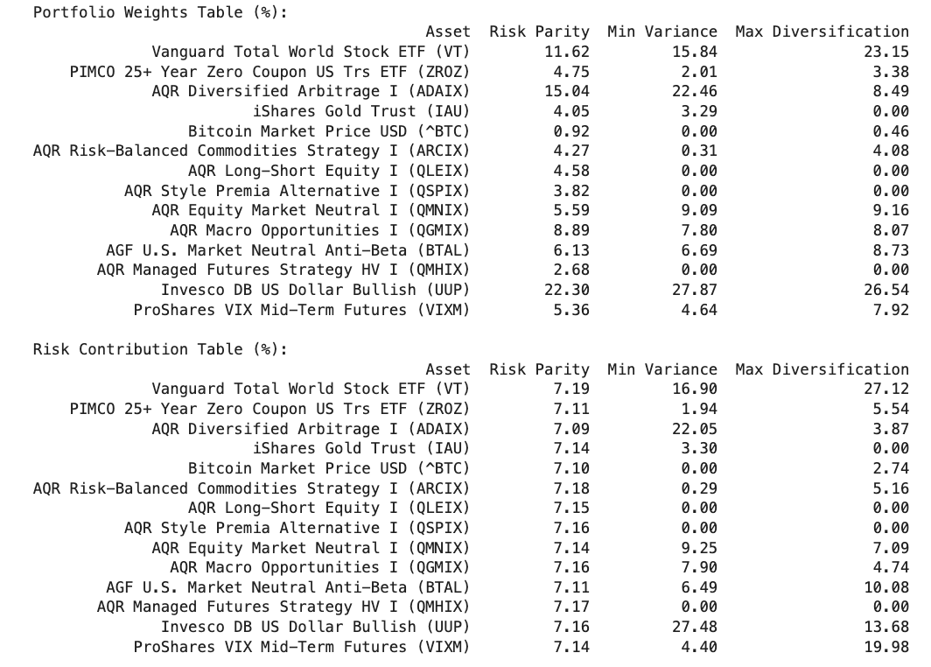
Model Analysis
Portfolio Weights Table
https://github.com/littlecl42/AAA500_FinalProject_CL_IL
Notes:
Portfolio Weights and Concentration
The portfolio weight allocation between Risk Parity, Minimum Variance, and Maximum Diversification has different approaches to risk management:
Risk Parity focuses on balancing risk contributions across assets. The weights are distributed so that each asset's risk contribution is equal. This approach generally results in a more evenly distributed portfolio than minimum variance or maximum diversification, leading to a relatively lower concentration.
Minimum Variance minimizes the portfolio’s overall risk, irrespective of asset returns. This excludes many assets from the portfolio, concentrating on those with the lowest risk. The technical report emphasizes that this portfolio lies on the efficient frontier’s leftmost tip and uses only a tiny proportion of the investable set due to constraints such as a long-only approach and shrinking beta thresholds (which excludes assets with high systematic risk. ​
Maximum Diversification aims to maximize the diversification ratio, selecting assets that contribute most to diversification benefits. Weights are determined by a ratio of asset volatilities to overall portfolio risk, which results in an allocation that favors assets contributing the least to overall risk. It tends to employ more assets than the minimum-variance approach, providing a compromise between diversification and risk control.

Slide 37
Model Analysis
Risk Contribution Table
https://github.com/littlecl42/AAA500_FinalProject_CL_IL
Notes:
Risk Contribution
The Risk Contribution Table shows how the portfolios achieve diversification
In the risk parity approach, the contributions from each asset are more uniform, reflecting its aim to balance risk evenly.
Minimum variance portfolios tend to be heavily skewed towards low-risk assets, resulting in uneven risk contributions, which also explains the higher portfolio concentration.
Maximum diversification aims to reduce correlations among assets, resulting in weights proportional to each asset's ability to diversify risk rather than its volatility.

Slide 38

Model Analysis
Performance Metrics Table
https://github.com/littlecl42/AAA500_FinalProject_CL_IL
Notes:
Performance Metrics
Regarding performance, Risk Parity shows the highest CAGR (5.38%) and lowest maximum drawdown (-2.87%) compared to other strategies, consistent with its objective of balancing risk and potentially avoiding concentration in highly volatile assets.
Minimum Variance has the lowest standard deviation (2.35%) and a relatively low CAGR (4.66%), indicating that while it successfully minimizes risk, it may also sacrifice potential returns.
Maximum Diversification sits between the two, providing a reasonable balance between CAGR and volatility (4.71% and 2.61%, respectively). It is designed to provide better returns than a purely minimum-variance approach while reducing risk through diversification benefits.

Slide 39
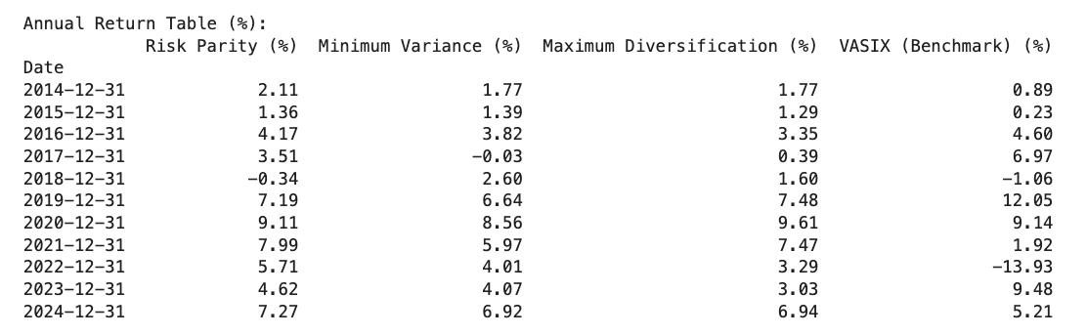
Model Analysis
Annual Return Table
https://github.com/littlecl42/AAA500_FinalProject_CL_IL

Slide 40
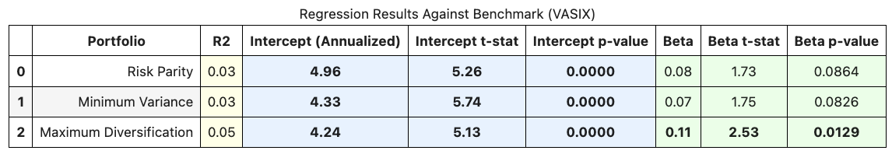
Model Analysis
Regression Results Table
https://github.com/littlecl42/AAA500_FinalProject_CL_IL
Notes:
Regression Results
The Regression Analysis Table reveals that the intercepts for all three portfolios are statistically significant, indicating potential alpha relative to the benchmark (VASIX).
Risk Parity has a beta of 0.08, suggesting it is less prone to market movements than other portfolios. This makes it an appealing option for risk-averse investors.
The Maximum Diversification portfolio exhibits a higher beta (0.11) than the other two, aligning with its approach to seeking diversification while tolerating higher market sensitivity.
Data Limitations and Specific Timeframes
The results are subject to the characteristics of the underlying asset set and the particular timeframe used in the analysis. Different market environments might yield different results, especially for Minimum Variance portfolios that rely on historical correlations and volatilities that can shift dramatically.
Model Assumptions
The portfolios are optimized under certain assumptions, such as constant asset covariance and using historical returns for risk estimation. These assumptions may not hold in periods of extreme market stress, leading to deviations from the expected portfolio performance.
For example, the Risk Parity approach, while robust during normal market conditions, could be vulnerable to extreme changes in correlation structures across assets, which might cause the intended balance of risk contributions to become less effective.

Slide 41
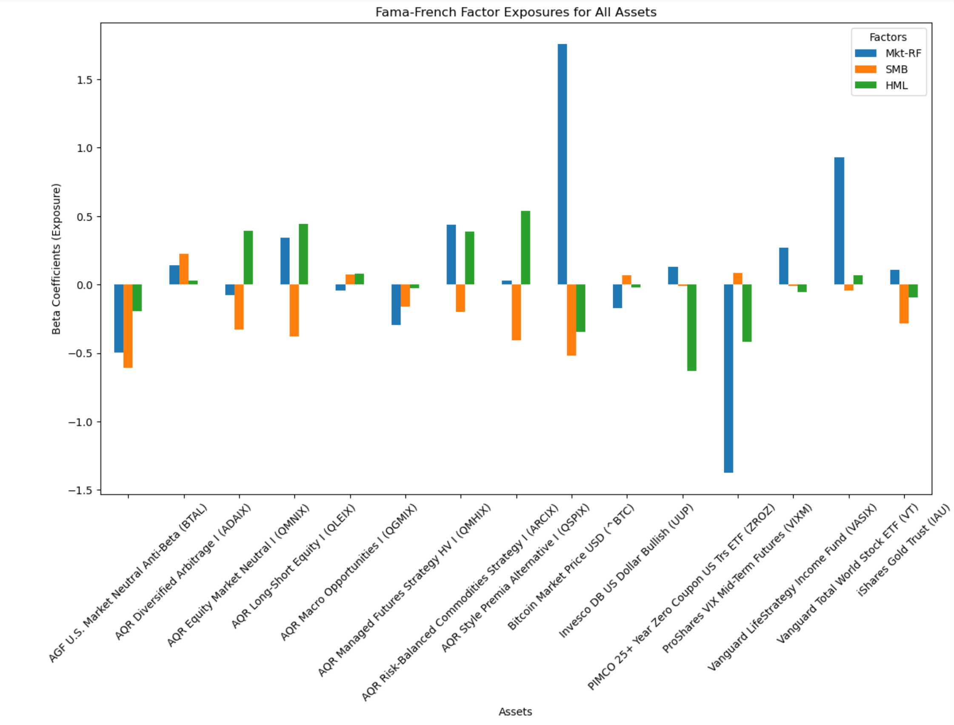
Model Analysis
Fama French Factors
https://github.com/littlecl42/AAA500_FinalProject_CL_IL
Notes:
Fama French Factors
Betas (𝛽1,𝛽2,𝛽3) represent the asset’s sensitivity to each factor.
A high 𝛽1 (market) means the asset is strongly correlated with market movements.
A positive 𝛽2 (SMB) means the asset has small-cap exposure.
A positive β3 (HML) means the asset has exposure to value stocks.

Slide 42
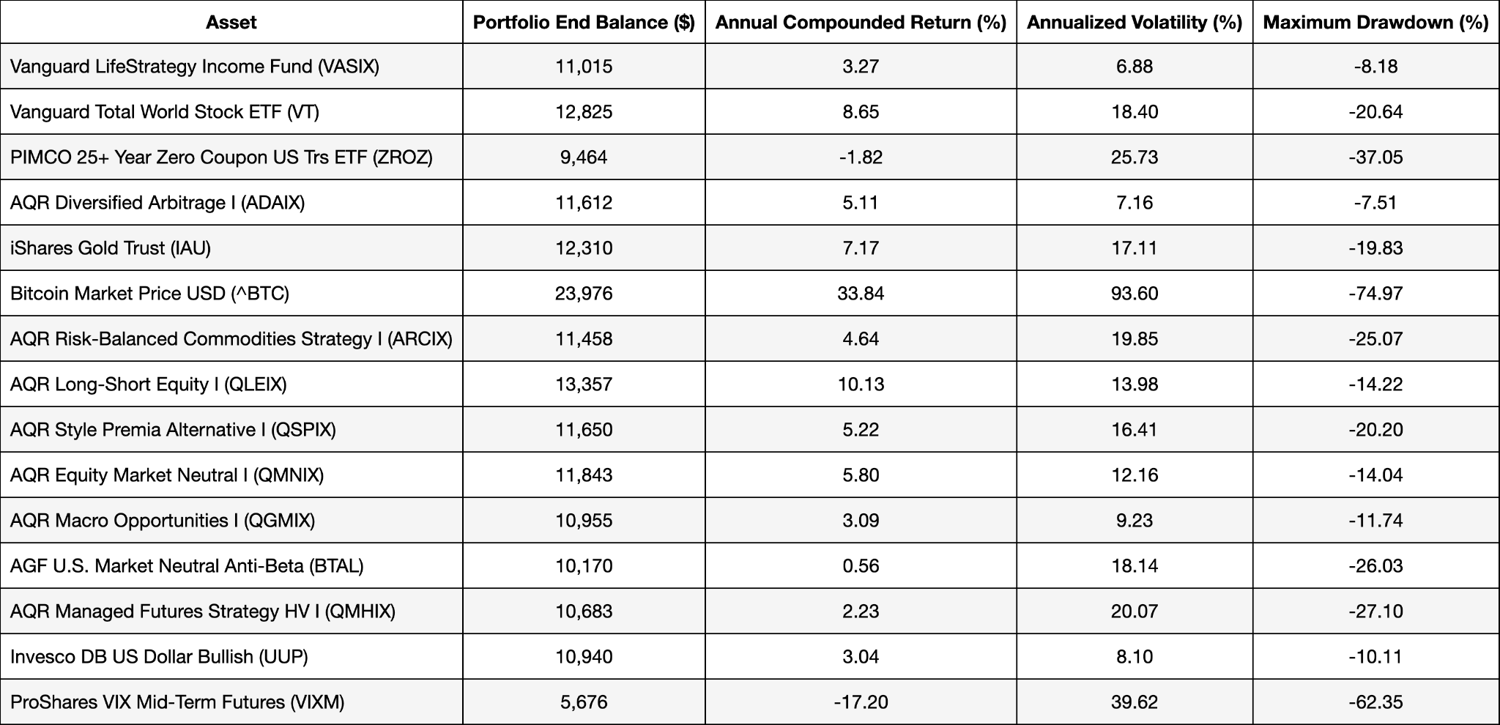
Monte Carlo Analysis, 50th Percentile (36-mo., 10,000 iterations)
https://github.com/littlecl42/AAA500_FinalProject_CL_IL

Slide 43
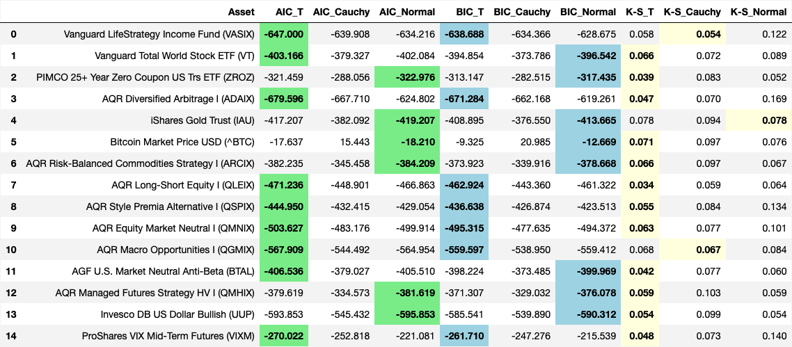
Quantitative Goodness of Fit Tests AIC, BIC, K-S
https://github.com/littlecl42/AAA500_FinalProject_CL_IL
Notes:
Quantitative Goodness of Fit Tests AIC, BIC, K-S
Vanguard LifeStrategy Income Fund (VASIX)
Both AIC and BIC indicate that the T distribution fits best, with lower values compared to the Cauchy and normal distributions.
The K-S statistic is also the lowest for the T distribution, confirming the visual interpretation that the T distribution captures the return characteristics more accurately than the normal or Cauchy distributions.
Vanguard Total World Stock ETF (VT)
AIC and BIC both favor the T distribution, showing lower scores than the Cauchy and normal distributions. The K-S test also suggests a better fit with the T distribution, supporting the previous observation of heavy tails that the normal distribution fails to capture.
PIMCO 25+ Year Zero Coupon US Treasury ETF (ZROZ)
The T distribution has the lowest AIC and BIC values, indicating it best fits this dataset. The K-S statistic is also the lowest for the T distribution, consistent with earlier findings regarding the tail behavior of ZROZ.
AQR Diversified Arbitrage I (ADAIX)
AIC and BIC indicate that the T distribution is the best fit, with significantly lower scores than the other distributions. The K-S statistic is also the lowest for the T distribution, which matches the visual observation that the T distribution provides a better fit for ADAIX's moderate kurtosis.
iShares Gold Trust (IAU)
AIC and BIC favor the normal distribution, while the K-S test favors the Cauchy distribution by a narrow margin. This suggests that while the normal distribution captures the bulk of the data, the Cauchy may better fit the tails, indicating mixed behavior.
Bitcoin Market Price USD (^BTC)
The AIC and BIC both show the normal distribution having the lowest values, but the differences between distributions are not as pronounced. The K-S statistic is the lowest for the normal distribution; however, given the significant kurtosis visually observed, this quantitative result may indicate a sample size or testing methodology limitation.
AQR Risk-Balanced Commodities Strategy I (ARCIX)
AIC and BIC favor the normal distribution, suggesting that the return behavior can be reasonably approximated by it. The K-S statistic, however, is slightly lower for the T distribution, indicating a better fit for tail events.

Slide 44
Quantitative Goodness of Fit Tests AIC, BIC, K-S
https://github.com/littlecl42/AAA500_FinalProject_CL_IL
Notes:
Quantitative Goodness of Fit Tests AIC, BIC, K-S
AQR Long-Short Equity I (QLEIX)
AIC and BIC indicate the T distribution as the best fit, with lower values than the Cauchy and normal distributions.
The K-S test also suggests that the T distribution is the most appropriate fit, consistent with visual interpretations.
AQR Style Premia Alternative I (QSPIX)
The T distribution is favored by both AIC and BIC, with the lowest scores. The K-S statistic also indicates the T distribution fits best, aligning with earlier conclusions regarding moderate skewness and tail behavior.
AQR Equity Market Neutral I (QMNIX)
Both AIC and BIC values are lowest for the T distribution, indicating it as the best fit. The K-S statistic also suggests the T distribution is better at capturing the data, which aligns with the visual analysis.
AQR Macro Opportunities I (QGMIX)
AIC and BIC both favor the T distribution, with lower values than the Cauchy and normal distributions. The K-S test also points to the T distribution as the best fit, matching earlier observations of non-normal tail behavior.
AGF U.S. Market Neutral Anti-Beta (BTAL)
AIC and BIC indicate that the T distribution is the best fit, with the lowest scores compared to the others. The K-S test suggests the T distribution fits the data well, supporting negative skewness and moderate kurtosis observations.
AQR Managed Futures Strategy HV I (QMHIX)
The T distribution is favored by both AIC and BIC values, with the lowest scores. The K-S statistic also indicates that the T distribution is better at fitting the data, consistent with earlier visual interpretations of heavy tails.
Invesco DB US Dollar Bullish (UUP)
AIC and BIC indicate that the T distribution is the best fit, followed by the Cauchy distribution. The K-S test favors the T distribution, aligning with previous moderate kurtosis and tail risk observations.
ProShares VIX Mid-Term Futures (VIXM)
Both AIC and BIC values are lowest for the T distribution, suggesting it best fits the data. The K-S test also indicates a slightly better fit with the T distribution than the others, consistent with visual heavy tail behavior.

Slide 45
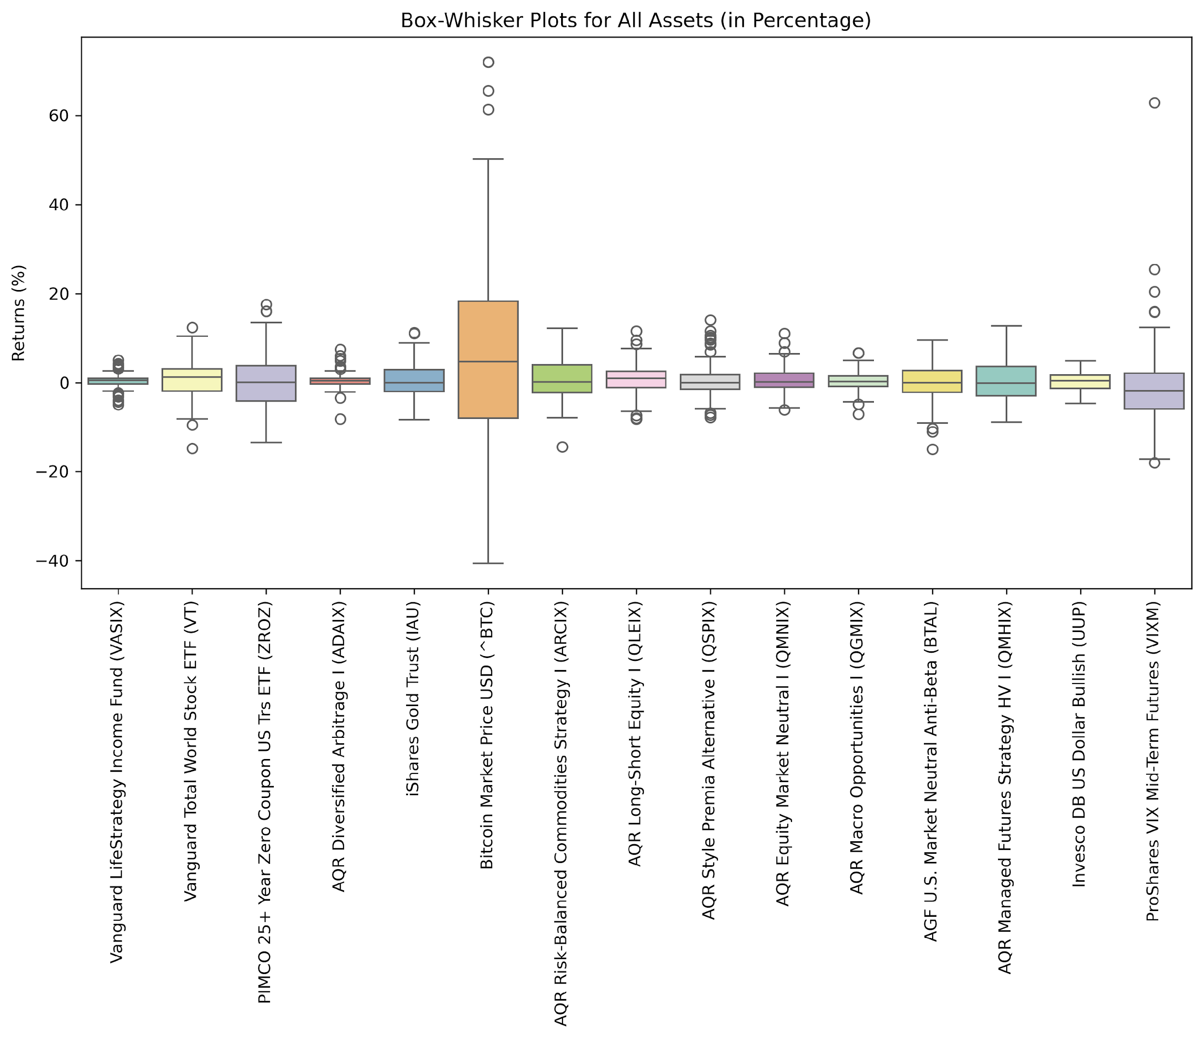
Box and Whisker Plot
https://github.com/littlecl42/AAA500_FinalProject_CL_IL
Notes:
Box and Whisker Plot
Vanguard LifeStrategy Income Fund (VASIX)
The box plot shows a narrow interquartile range (IQR) and limited whiskers, indicating low volatility and stable returns.
A few outliers are present, but overall, the distribution is consistent with the conservative, income-focused nature observed earlier.
Vanguard Total World Stock ETF (VT)
The plot shows a wider IQR than VASIX, with some outliers, indicating higher volatility and a greater range of returns.
This is consistent with previous observations regarding VT's global equity exposure and the higher risk-return trade-off.
PIMCO 25+ Year Zero Coupon US Treasury ETF (ZROZ)
The box plot for ZROZ displays a relatively large IQR and wide whiskers, suggesting significant volatility. The long duration of this bond ETF makes it highly sensitive to interest rate changes, which aligns with earlier observations about its risk profile.
AQR Diversified Arbitrage I (ADAIX)
The IQR is moderate, with a few outliers, indicating a balanced return distribution with occasional extreme events. This aligns with earlier observations of moderate kurtosis, suggesting relatively stable arbitrage returns with occasional deviations.
iShares Gold Trust (IAU)
The IQR is wider compared to VASIX, indicating moderate volatility. The whiskers extend further, capturing the tendency of gold to have variable returns depending on market sentiment. The presence of several outliers supports the idea that gold can occasionally experience extreme positive or negative returns.
Bitcoin Market Price USD (^BTC)
Bitcoin shows a significantly wider IQR and extended whiskers, highlighting its extremely high volatility. The presence of multiple extreme outliers supports previous conclusions regarding Bitcoin's potential for extreme returns, reinforcing its high-risk, high-reward profile.
AQR Risk-Balanced Commodities Strategy I (ARCIX)
The IQR is moderately wide, indicating some variability in returns. The whiskers show a balanced extension, with outliers present.
This aligns with previous observations that ARCIX has moderate volatility driven by commodity price fluctuations.

Slide 46
Box and Whisker Plot
https://github.com/littlecl42/AAA500_FinalProject_CL_IL
Notes:
Box and Whisker Plot
AQR Long-Short Equity I (QLEIX)
The relatively narrow IQR suggests controlled volatility, which is typical for long-short strategies. A few outliers suggest occasional extreme returns, consistent with previous analyses.
AQR Style Premia Alternative I (QSPIX)
The box plot shows a moderate IQR, indicating moderate return variability. The whiskers extend further, suggesting exposure to different styles can lead to diverse outcomes. Several outliers confirm the heavy tail behavior observed in previous statistical analyses.
AQR Equity Market Neutral I (QMNIX)
The box plot for QMNIX shows a narrow IQR, indicating low return variability. The whiskers are also short, supporting its market-neutral nature with low systematic risk. This supports previous findings that QMNIX has a relatively stable return distribution.
AQR Macro Opportunities I (QGMIX)
The IQR is more expansive, indicating that macroeconomic factors contribute to moderate return variability. Outliers in both directions suggest sensitivity to global economic changes, which is consistent with earlier observations.
AGF U.S. Market Neutral Anti-Beta (BTAL)
The IQR is moderate, with the whiskers extending slightly further, indicating moderate volatility. Negative outliers are observed, consistent with previous observations of negative skewness and the occasional downside risk of anti-beta strategies.
AQR Managed Futures Strategy HV I (QMHIX)
The box plot shows a wide IQR and long whiskers, indicating significant volatility and return variability typical of managed futures strategies. The presence of outliers aligns with earlier observations of high kurtosis and the unpredictable nature of such strategies.
Invesco DB US Dollar Bullish (UUP)
The IQR is narrow, indicating low return variability and consistent performance. The whiskers and outliers are limited, supporting earlier conclusions that UUP has a stable return profile driven by the value of the US dollar.
ProShares VIX Mid-Term Futures (VIXM)
The box plot shows a wide IQR and extended whiskers, indicating high return variability, which is typical for VIX-related products.
The presence of extreme outliers aligns with previous observations of significant tail risk and sensitivity to volatility shocks.

